Slide 1
School of Engineering Sciences in Chemistry, Biotechnology and Health

Slide 2
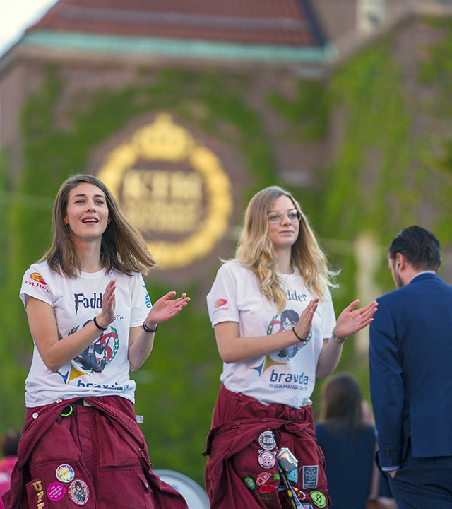
Sweden's largest technical university
14,000 full-time students
1,700 postgraduate students
3,600 full-time employees
Five campuses in the Stockholm area

Slide 3
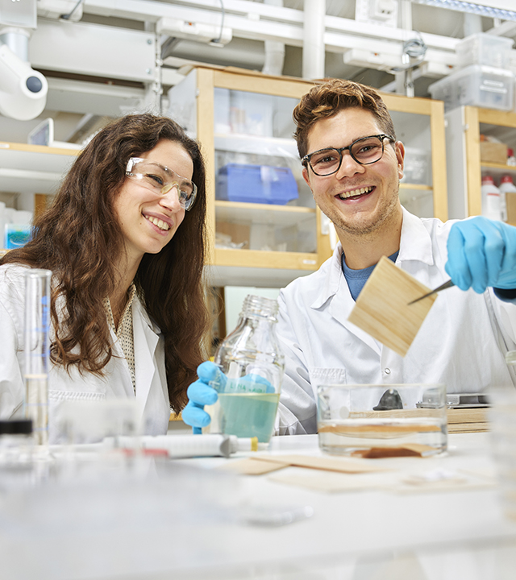
CBH School
KTH's second largest school
Over than 2,000 full-time students
365 postgraduate students
750 full-time staff
Four campuses

Slide 4
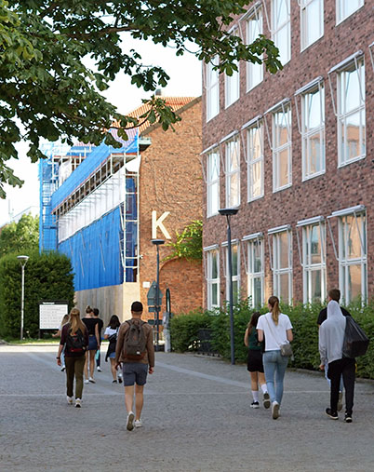
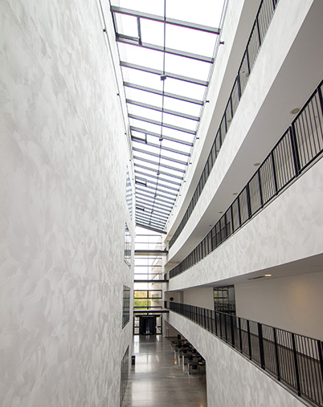

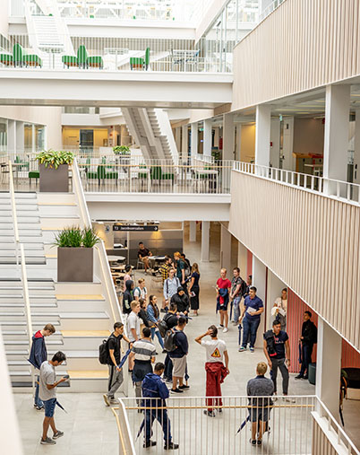
Research and education on four campuses
Valhallavägen
AlbaNova
Solna
Flemingsberg

Slide 5
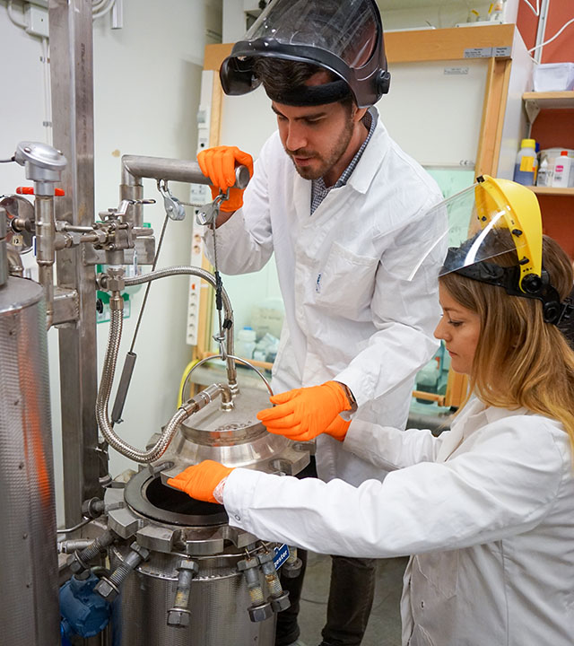
Research areas
Health
Materials
Energy
Environment

Slide 6
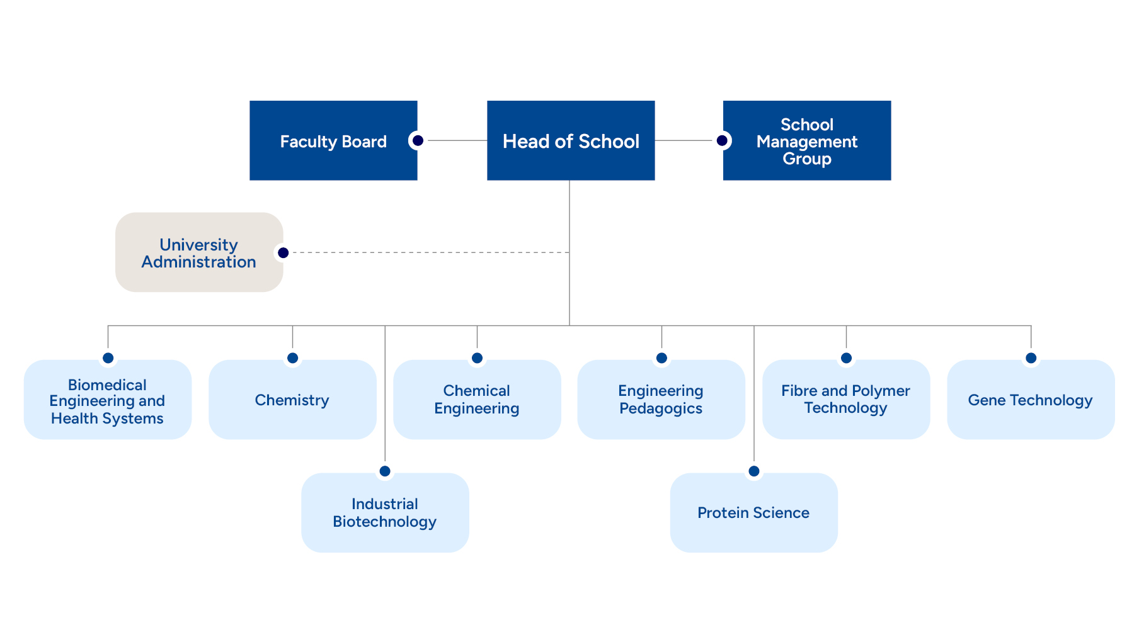
Organisation of the CBH School

Slide 7

Staff members
65 professors
45 associate professors
18 assistant professors
37 lecturers
172 researchers and research engineers
237 doctoral students
107 technicians and administrators

Slide 8
Economy and finance
Top ten external funders
Turnover is approximately SEK 1.3 billion.
External funding (40 %)
Grants for doctoral training (29 %)
Grants for undergraduate education (17 %)
Karolinska Institutet (20 %)
The Wallenberg Foundations (18 %)
Swedish Research Council (17 %)
EU (12 %)
Vinnova, Sweden's Innovation Agency (9 %)
Swedish Energy Agency (8 %)
Swedish Foundation for Strategic Research
(7 %)
Formas (4 %)
Swedish Armed Forces (3 %)
Novo Nordisk Foundation (2 %)

Slide 9
Education

Slide 10
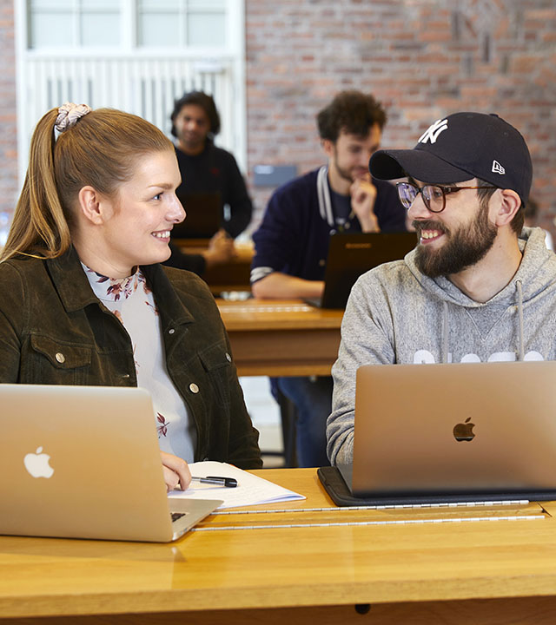
Technical Preparatory Year
Provides access to KTH's engineering programmes.
Study techniques for the future.
Opportunity to apply for a reserved programme place at KTH after completed studies.

Slide 11
Bachelor of Science in Engineering
Master of Science in Engineering
Datateknik
Elektroteknik
Kemiteknik
Medicinsk teknik
Teknik och ekonomi
Bioteknik
Teknisk kemi
Medicinsk teknik

Slide 12

Master's programmes
Chemical Engineering for Energy and Environment
Industrial and Environmental Biotechnology
Innovative Technology for Healthy Living
Macromolecular Materials
Medical Biotechnology
Medical Engineering
Molecular Science and Engineering
Molecular Techniques in Life Science
Polymer Technology
Sports Technology
Technology, Work and Health

Slide 13
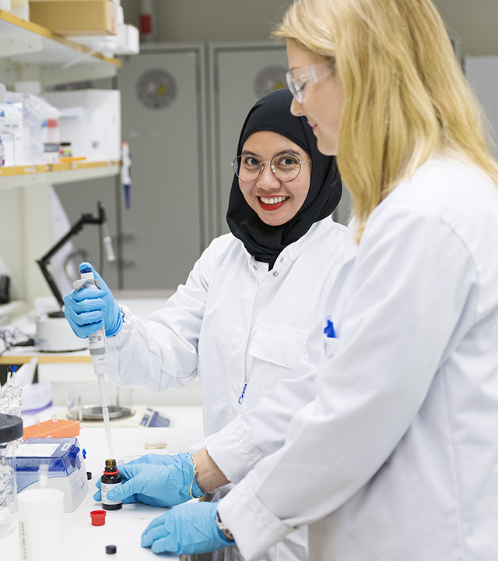
Doctoral programmes
Chemical Science and Engineering
Biotechnology
Theoretical Chemistry and Biology
Medical Technology
Technology and Health

Slide 14
Research

Slide 15

Global challenges
The need of sustainable energy
Health and an ageing population
Climate change
Sustainable production and working life
Food production
Clean water

Slide 16

Research centres
2MILab
AdBIOPRO
AIMES
Batteries Sweden (BASE)
CellNova
CEM4MAT
Centre for Data Driven Health (CDDH)
Greenhouse Labs
Human Protein Atlas
Integration Lab
KTH Center for Sports Engineering
Notes:
KI is the principal of AIMES. Uppsala University is the principal of BASE.

Slide 17

Research centres
KTH FOOD
MedTechLabs
National Genomics Infrastructure (NGI)
Production, use and storage of hydrogen (PUSH)
Swedish Gasification Centre (SFC)
Sjöstadsverket (SWIC)
Swedish Aerospace Physiology Centre (SAPC)
The Jonasson Centre for Medical Imaging
Treesearch
Wallenberg Center for Protein Research (WCPR)
Wallenberg Wood Science Center (WWSC)
Notes:
KTH FOOD researches the food of the future. Increasing the use of cultivated cereals has benefits for both health and the planet. The picture shows older varieties of wheat, such as emmer and spelt.

Slide 18
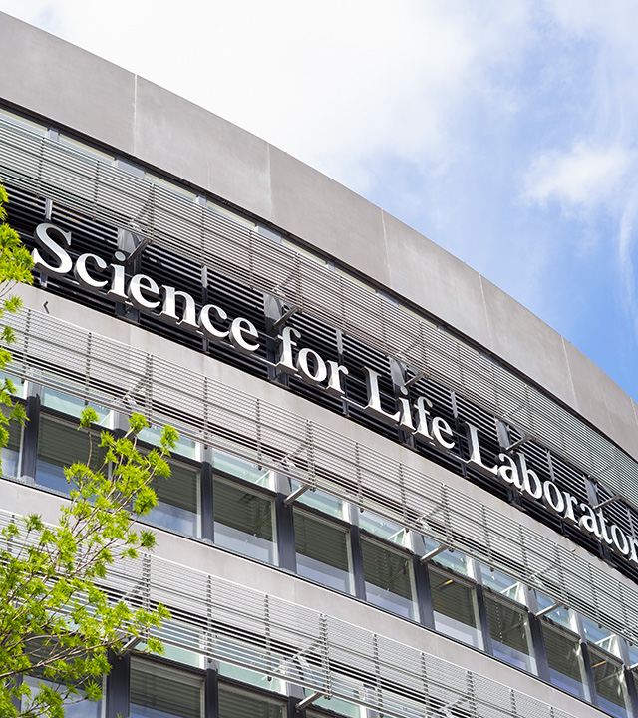
SciLifeLab
A national institution for molecular biosciences.
Health and environment research.
Combines leading technical expertise with advanced knowledge in translational medicine and molecular biological sciences.
Run by Karolinska Institutet, KTH, Stockholm University and Uppsala University.

Slide 19

NGI Sweden
One of the world's largest centres for genomics, the study of genetic material.
Provides technology and expertise to rapidly sequence large amounts of DNA.
Designated as a national infrastructure by the Swedish Research Council.

Slide 20
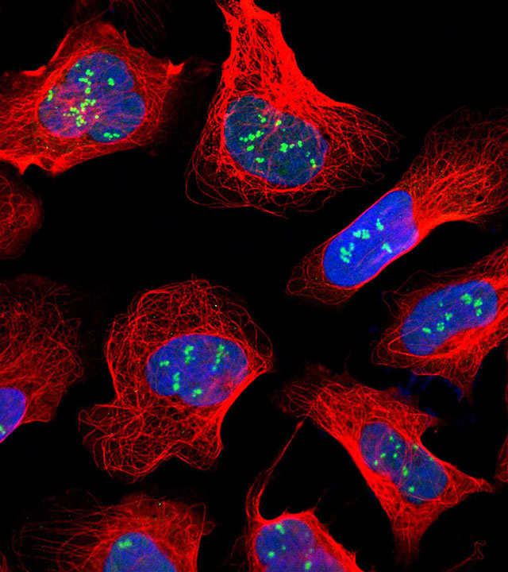
Protein atlas and Blood atlas
Database designated as a global resource in 2023.
Mapping human proteins.
Better diagnostics and new treatments.

Slide 21

Treesearch
Research on new materials from the forest.
Collaboration between academia and industry.
Platform open to all researchers and research projects at Swedish universities.

