Slide 1
Dilemma exercise
We are each other's working environment!
Notes:
Introduce yourself and the exercise

Slide 2
The president’s prioritized work environment issues for 2018-2019
In order to increase awareness for these important issues within KTH’s work environment, the president has decided that discrimination, harassment, sexual harassment and abusive treatment are the President’s prioritized work environment issues for 2018-2019.
Notes:
Read the text as written on the slide

Slide 3
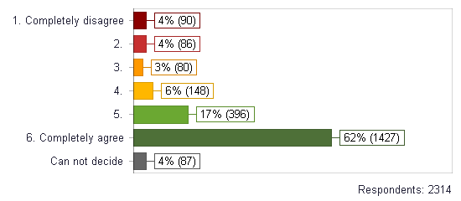
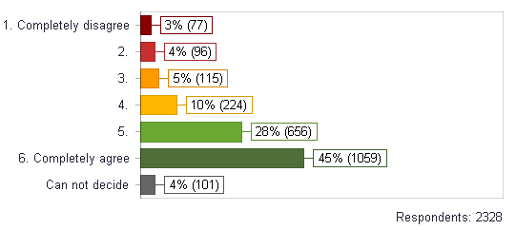
Employee survey 2018
In my department/group, I feel confident and free from bullying and abuse
I find my department/group to be a workplace free from discrimination regardless of ethnicity, disability, gender, transgender identity, sexual orientation, religion or age.
Notes:
The results from both year 2016 and 2018 show that there is room for improvement.
Despite a ”green” result, the red numbers indicate that we have a lot of individuals in KTH that don’t agree to;
feeling free from being bullied and violated in their workplace
Having a workplace that is free from discrimination (based on sex, Transgender identity or expression, Ethnicity, Religion or other belief, Disability, Sexual orientation, Age) This, among other reasons, is why we are doing this exercise today.

Slide 4
Purpose
Raise awareness and increase knowledge about KTH Code of Conduct and zero tolerance of:
Discrimination
Harassment
Sexual harassment
Abusive treatment
Keep an open dialogue based on mutual trust and respect
Notes:
Read the purpose as written on the slide

Slide 5
KTH Guidelines on work enviroment: ”Work enviroment is defined as all the factors that affect employees and students at KTH”
Operational requirements, resources and operational responsibilities
Pace of work
Exposure to chemicals
Management and control
Participation and influence over work
Ergonomics
Social interaction & cooperation
Equipment
Ventilation & heating/cooling
Feedback and social support from managers/
colleagues
Notes:
As of now, we have spoken about the bakground to this exercise, why it has been created and why we att doing it. Now, we will go trough a couple of slides that will help us create a common ground regarding terminology.
Read the text regaring KTH Gudielines.
Talk about physcial factors and then organizational and psychosocial factors. End with pointing out that the circles ”Social interaction and cooperation” and ”Feedback and social support from managers / colleagues” are the main two work enviroment factors that will be touched by the exercise today.

Slide 6
I..
contribute to a good working climate
KTH Code of Conduct
A good work environment:
contributes to creativity and health,
provides the preconditions for
Good performance,
Work results
Development of KTH.
KTH Guidelines on work enviroment
Lead by example, professional approach
Manager leads operations and distributes working tasks
KTH regulations
We are each other's work environment and this impacts our approach when we interact and communicate with each other at the workplace.
KTH Gudielines on Employeeship
Understand the importance of good cooperation
I am..
aware of zero tolerance of discrimination, harassment, sexual harassment and abusive treatment
KTH Code of Conduct
Notes:
1 – KTH Guidelines on work enviroment state that a good work environment contributes to creativity and health, provides the preconditions for good performance,, work results and development of KTH.
2 – KTH guidelines on employeeship state that we are each other's work environment and this impacts our approach when we interact and communicate with each other at the workplace.
As an attachemnt to the Employee Guidlines, and also as part of our employments, we have KTH Code of conduct. It’s nowdays also attached to the employee contract.
The Code of conduct is based on KTH’s ethical policy and KTH’s values. The Code of onduct was introduced year 2016 and contains of six codes / parts. Let’s have two of them in mind today, while doing the exercise;
3 – first one is that: ”I contribute to a good working climate”,
4 – second one is that: ” I am aware of zero tolerance of discrimination, harassment, sexual harassment and victimisation”
which among other things, means that I don’t discriminate or harass others but also that I act if I perceive discrimination, harassment, sexual harassment or abusive treatment among colleagues and / or students.
There are also three other parts of the Code of conduct, I will however not address them furthur today, but I do whant you all yo see the whole picture

Slide 7
Exercise
We are each other's working environment
Groups of 4-5
Instructions:
Read silently
Choose an alternative - ”What would you do?”
Show your card to the group and tell your thoughts
Notes:
Formulera din egen beskrivning för att nu introducera själva övningen.
Ursprunget för den här metoden är prövad med framgång på en annan myndighet. Vi har tagit delar av metoden och anpassat till vår verksamhet.

Slide 8
1
You’ve been emailing with a colleague for several days, the two of you are exchanging information regarding your work tasks. You feel like there is an unpleasant tone in his/her writing, personally targeted and almost offensive. You’ve maintained a professional tone and start to wonder if the colleague’s bad tone has something to do with you having a different background. What do you do?
You talk to your manager for advice and support.
You choose not to make a big deal of it.. You accept the situation and ignore your colleague’s tone.
You talk with other colleagues about what you’re experiencing.
Since you don’t know what to do in such situations, you read KTH Guidelines regarding discrimination and abusive treatment and act on the basis of it.
You contact the HR-department an tell them what you’re experiencing.
You talk to the person in question and tell him / her how he / she is making you feel.
If you experience something unpleasant, unfair or incomprehensible, courage and trust is needed in order to say what you experience, as well as the basis in order to take action to achieve a good working environment.
Notes:
The participens read the text silently

Slide 9
2
You notice several times that a colleague is being treated unfairly by other colleges. He/she often appears to be withdrawn and you notice how other colleges exclude the person from conversations and talk behind his/her back. You don’t understand why they are behaving this way and you feel concerned. What do you do?
You talk with other colleagues to find out if there is a reason to the situation.
You talk to your manager and tell him/her what you’re seeing and hearing.
You talk to the person in question and offer your company.
This doesn’t really concern you.. You focus on your work tasks.
Since you don’t know what to do in such situations, you read KTH Guidelines regarding discrimination and abusive treatment and act on the basis of it.
You contact HR an tell what you’re experiencing.
If you experience something unpleasant, unfair or incomprehensible, courage and trust is needed in order to say what you experience, as well as the basis in order to take action to achieve a good working environment.

Slide 10
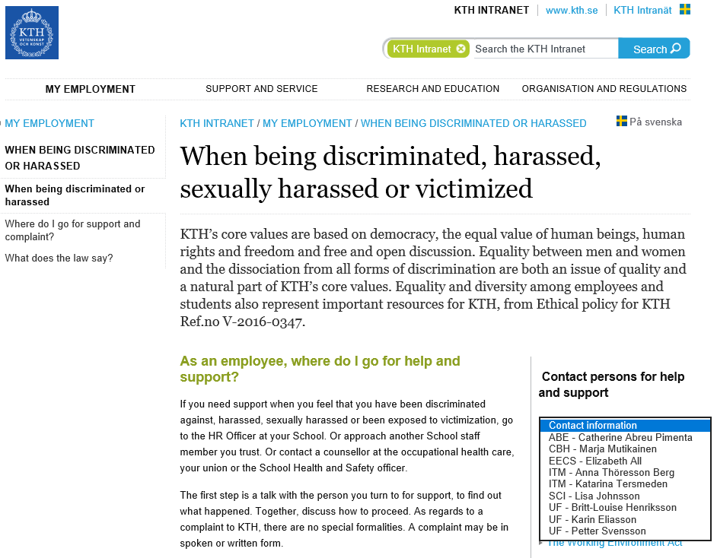
Notes:
End with showing the participants were to find contact information to HR, for advice and support, to ask something, or to report somenthing

Slide 11
We are each other's working environment!
Thank you

