Slide 1
School of
Industrial Engineering and Management

Slide 2
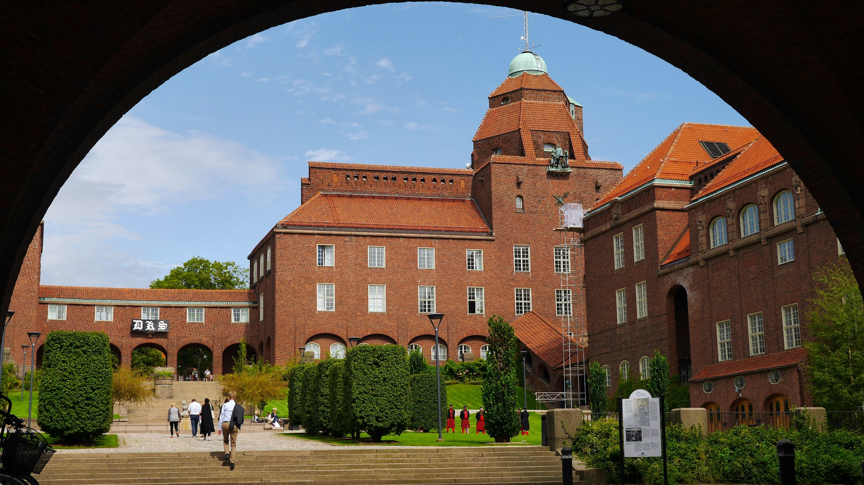

Slide 3
KTH in figures
17
155th
9
Master of Science in Engineering Programmes
best university in the world
Bachelor of Science in Engineering Programmes
1,582
4,026
42rd
Doctoral students
employees
1,334
best university
in Europe
13,583
Degree of Master of Science in Engineering, yearly
full time equivalent students

Slide 4
KTH's organisation
The University Board
University Administration
President
Faculty Council
Architecture and the Built Environment
Industrial Engineering and Management
Engineering and Computer Science
Engineering Sciences
Engineering science in Chemistry, Biotechnology and health

Slide 5
The ITM Management team
Deputy Head of School
Head of School Pär Jönsson
Second Deputy Head of School
Anna Jerbrant
Mats Magnusson
FFA
Andrew Martin
Head of Departments and University Administration ITM
Industrial Economics and Management
Engineering Design
Material Science and Engineering
Energy Technology
JMLA
Learning
Production
Engineering
University Administration
University Administration
Martin Edin
Deputy Head of Administration
Jenni Hollbrink
Grimheden
Head of Dept.
Cali Nuur
Head of Dept.
Martin Edin
Grimheden
Head of Dept.
Joakim Odqvist
Head of Dept.
Arnold Pears
Head of Dept.
Björn Laumert
Head of Dept.
Magnus
Wiktorsson
Head of Admin. Christina Carlsson

Slide 6
Core business ITM
Faculty
326 employees and affiliated
41 Professors, 14 Adjunct / Affiliated Professors, 62 Associate Professors, 10 Assistant Professors, 64 Lecturers, 19 Postdocs and 116 Researchers.
Third-cycle education
171 Doctoral Students
First and second cycle education
Approx 3200 students
Notes:
Doktorander och studenter uppdaterat 2021-05-06
Fakultet uppdaterat 2021-02-22

Slide 7
Core business ITM
Faculty
Andrew Martin Responsible for Future Faculty
Third-cycle education
Mats Magnusson
Second Deputy Head of School and Director of Third-Cycle Education
First and second cycle education
Anna Jerbrant
Deputy Head of School and Director of First and Second Cycle Education

Slide 8
Administration
Service Center
HR
Finance
School's Office for Student Affairs
Operations Controllers
Communi-cations
85 employees

Slide 9
Internationalisation
Notes:
We collaborate with a lot of organisations and universities around the globe.

Slide 10
Studies
Y 9
DOCTOR OF PHILOSOPHY
Y 8
Third Cycle
Y 7
LICENTIATE OF ENGINEERING
Y 6
Y 5
Second Cycle
MASTER OF SCIENCE
Y 4
MASTER OF SCIENCE
IN ENGINEERING
Y 3
BACHELOR OF SCIENCE
IN ENGINEERING
First Cycle
Y 2
Y 1

Slide 11
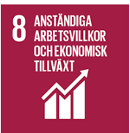
Programmes in first and second cycle
Master of Science in Engineering Programmes (300 credits)
Engineering and Education
Energy & Environment
Industrial Engineering and Management
Industrial Technology and Sustainability
Materials Design and Engineering
Mechanical Engineering
Design and Product Realisation
Bachelor of Science in Engineering Programmes (180 credits)
Industrial Technology and Production Maintenance
Mechanical Engineering

Slide 12
Programmes in third cycle
Doctoral Programmes
Energy and Environmental Systems
Industrial Economics and Management
Production Engineering
Machine Design
Engineering Materials Science
Education and Communication Studies
Notes:
https://www.kth.se/itm/utbildning/forskarutbildning

Slide 13
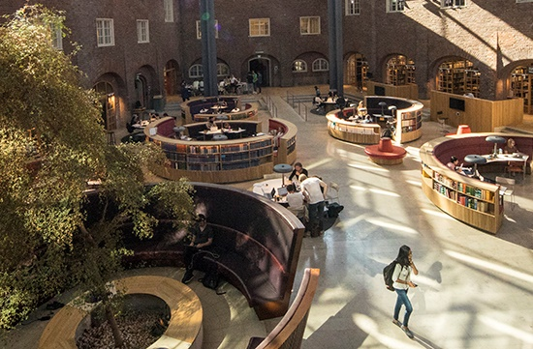
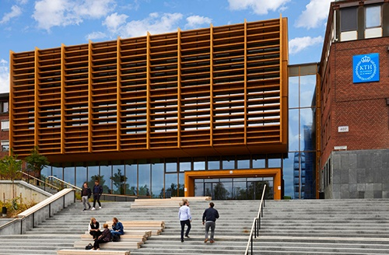
Our campuses
KTH Campus
Most of the Master of Science in Engineering Programmes are located on KTH Campus as well as several common student support functions.
Address: Brinellvägen 8, 100 44 Stockholm,
KTH Södertälje
The programmes have close connection to the private sector, and the students have ongoing contact with companies like Scania and AstraZeneca.
Address: Kvarnbergagatan 12, 151 81 Södertälje,

Slide 14
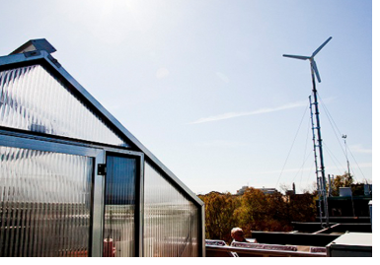
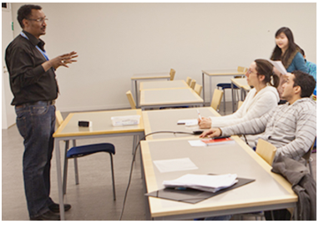
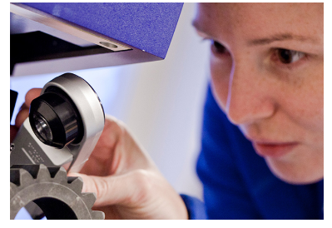
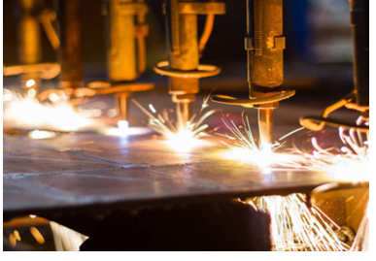
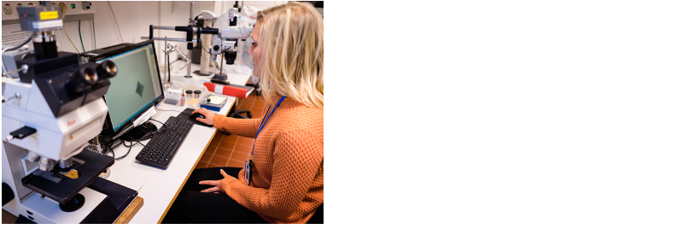
Research areas
Energy Technology
The Department of Energy Technology aims at contributing to welfare and development through world class research and education in innovative energy technologies and systems, and promotion of the energy sector transition towards sustainability.
Industrial Economics and Management
Research in economics, business management and organization. Behind the profile of the department is a firm conviction that modern society has a need for expertise in advanced technical depth combined with strong insights into the economy and leadership.
Learning
The department has developed research into learning in order to take a holistic approach to research in learning at all levels, from pre-school to college. Current research areas are digital learning, global competence, engineering education in society, studies in higher education organization (HEOS) and the didactics of science and technology.
More about
research on kth.se/itm/forskning
Engineering Design
Product development is the overarching theme of research at the department. The inter-disciplinary research activities can be summarized in the study of the development process, techniques and design principles as well as those related to physical phenomena.
Production Engineering
The research aims to create sustainable industries and covers all technologies which mainly applies engineering technical development of products and methods that have direct impact on this production. The area includes all aspects from design to production to assembly of parts into functional products as well recycling issues.
Materials Science and Engineering
The research is conducted on metallic and ceramic materials covering the whole chain Processes – Structures – Properties. The activities include experimental work as well as modeling on different length scales.
Notes:
https://www.kth.se/en/itm/forskning

Slide 15
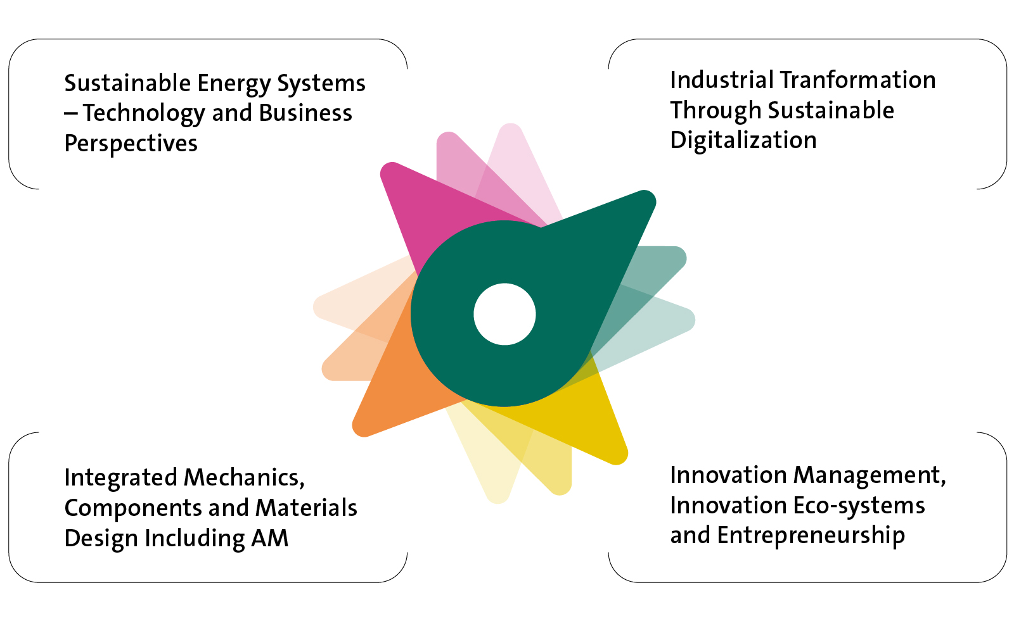
Research Initiative on Sustainable Industry and Society (IRIS)
IRIS is an overall school initiative that started in 2019 with the aim of contributing to increased sustainability in industry and society.
The goal of IRIS is to create strong research environments at the ITM school, and to stimulate new collaborations within and outside the school. IRIS represents a unique opportunity to establish the school at the forefront in research on sustainable industry and society.
Areas of activity
More about IRIS on kth.se/en/itm
Notes:
https://www.kth.se/en/itm/forskning/iris

Slide 16
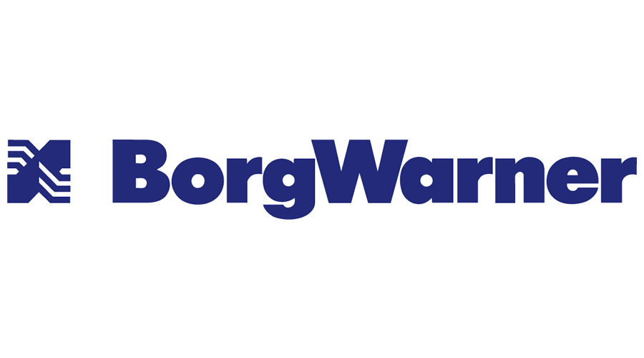
Co-operation
2019
Notes:
Some examples of partners.

Slide 17
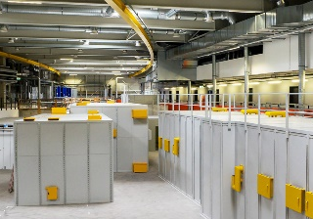
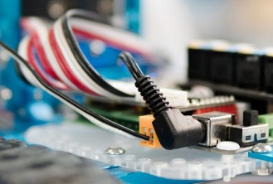
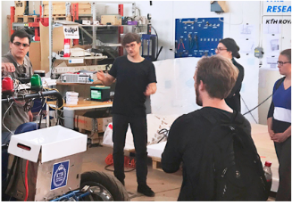
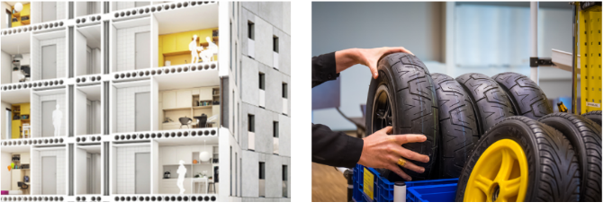
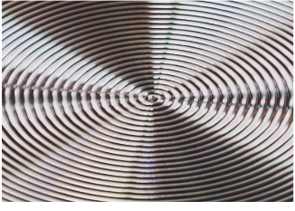
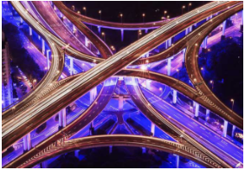
Co-operation - Competence centres
Center for X-rays in Swedish materials science (CeXS)
CeXS is engaging material science researchers in the opportunities of using high-energy x-rays, and aim to strengthen international collaborations in the field.
Director: Peter Hedström
Climate Action Centre
KTH Climate Action Centre is a multidisciplinary research centre where we work together to speed up climate action in synergy with the UN Sustainable Development Goals.
Director: Francesco Fuso-Nerini
Design & Management of Manufacturing Systems (DMMS)
DMMS is a center of excellence in the field product development with a focus on production. In close collaboration with its partners Scania, Sandvik, Swerea IVF and Chalmers MCR, they spread competence within areas like advanced component manufacturing, methodology and digital production support.
Director: Andreas Archenti
KTH:s centrum i inbyggda system (ICES)
ICES involves members from several KTH schools working closely with a wide range of industrial partners. The aim is to tackle the issues faced by those researching and working in the increasingly complex field of embedded systems today.
Director: Martin Törngren
Integrated Transport Research Lab (ITRL)
ITRL is a multidisciplinary and multi-stakeholder arena. Our mission is to explore sustainable mobility solutions that greatly reduce CO2 emissions and are economically viable and socially accepted.
Director: Jonas Mårtnesson
KTH Live-In Lab
The KTH Live-In Lab platform of multiple testbeds can handle many different potential products and services, both separately and combined in a real system.
Director: Jonas Anund Vogel
Lean Center
Competence center with a focus on management and systematic improvement of work processes and organizations. Lean Center is a link between research, business and the public sector, and offers education, seminars and qualified coaching.
Director: Johanna Strömgren
Center for Mechanics and Materials (MMD)
The Center brings together the two disciplines Mechanics and Materials Science in order to speed up the processes for producing better materials. The long-term goal is a renewed and strengthened education at the basic, advanced and research levels in the field.
Director: Carl Dahlberg
Trustworthy Edge Computing Systems and Applications (TECoSA)
TECoSA is a Vinnova center with 13 industrial partners. Its aim is to provide safe and secure edge computing technology. Edge computing is a new computer level located between the devices/embedded systems and the cloud, on the “edge of the cloud”.
Director: Martin Törngren
Notes:
kth.se/en/itm/samverkan

Slide 18
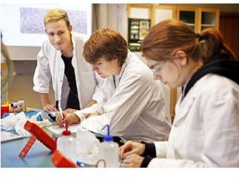
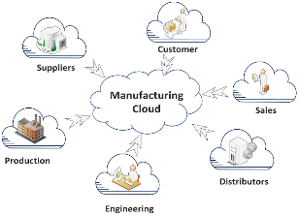
Co-operation Other center like organisations
More about
co-operations on kth.se/itm/samverkan
House of Science (Vetenskapens Hus)
Welcome to Stockholm and Vetenskapens Hus to explore modern science subjects including biology, chemistry, mathematics, physics as well as engineering.
Director: Marcus Angelin
Excellence in production research (XPRES)
XPRES is a platform for production research to meet the future challenges for the Swedish industry.
Director: Antonio Maffei
Notes:
kth.se/en/itm/samverkan

