Slide 1
Organisation
ABE

Slide 2
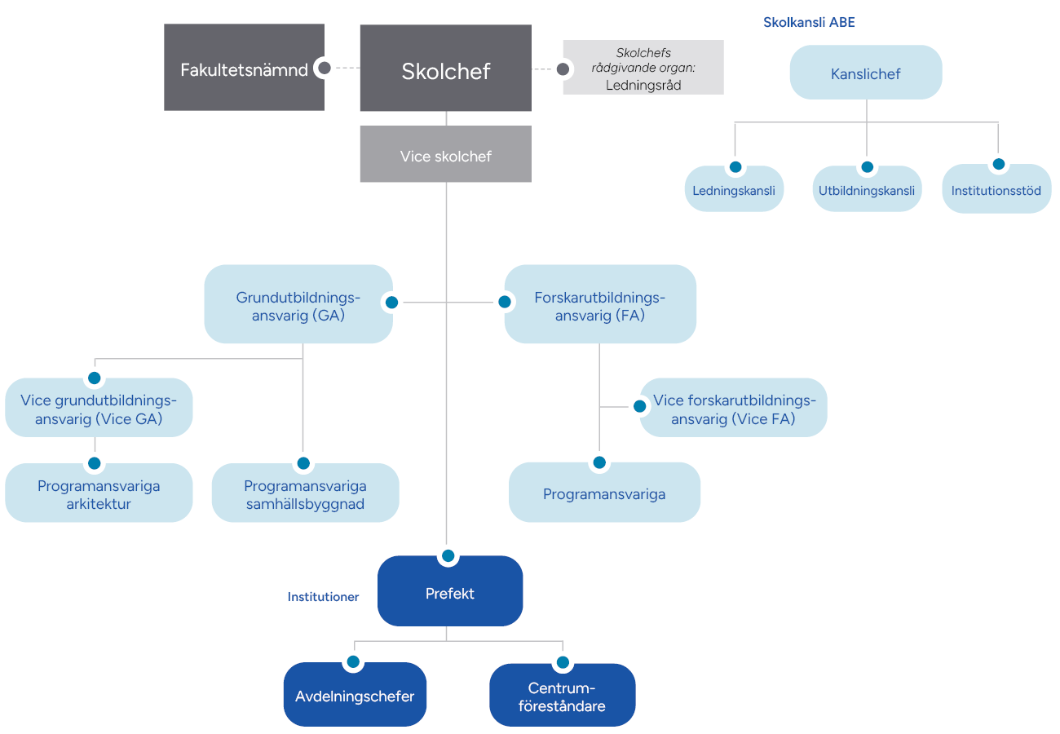
Organisation

Slide 3
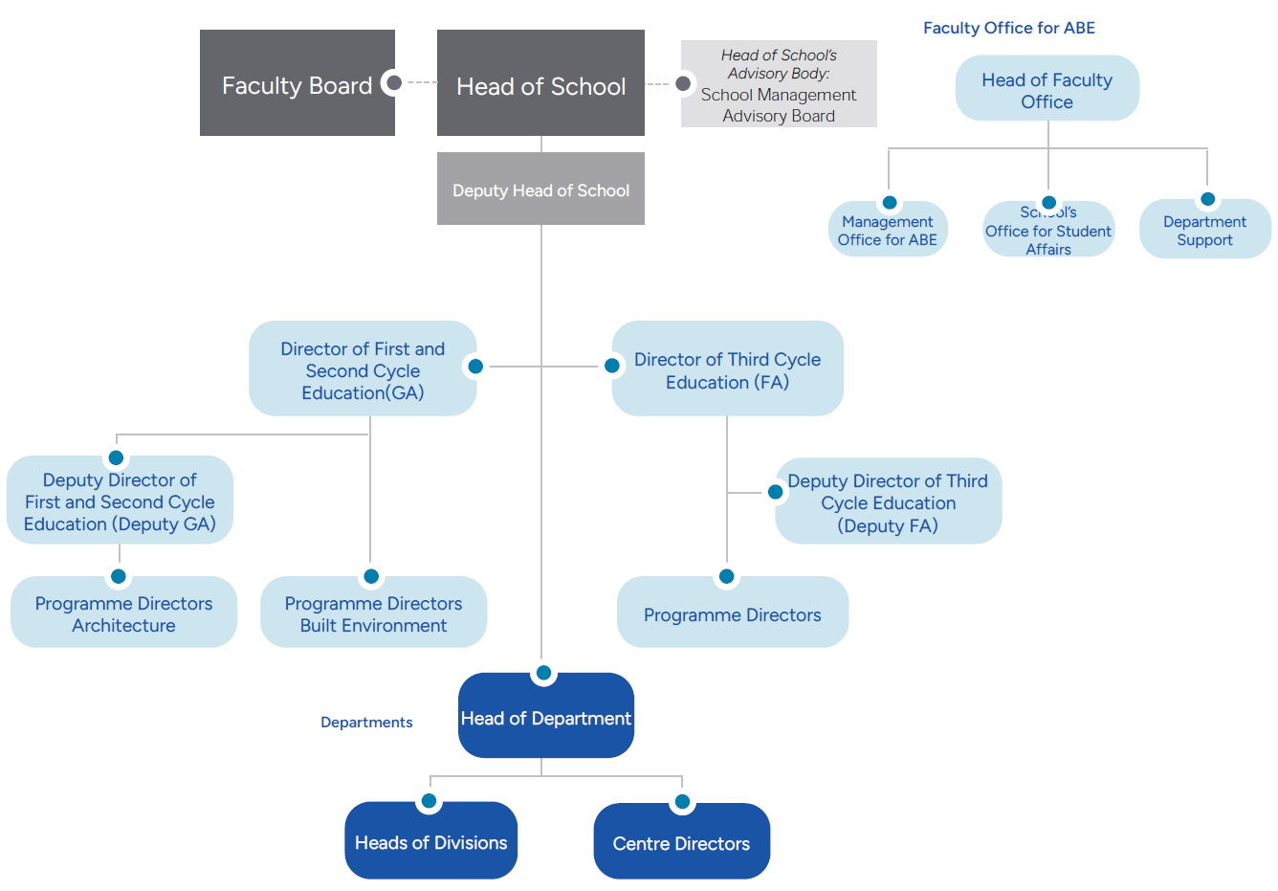
Organisation

