Slide 1
Organisation ABE

Slide 2
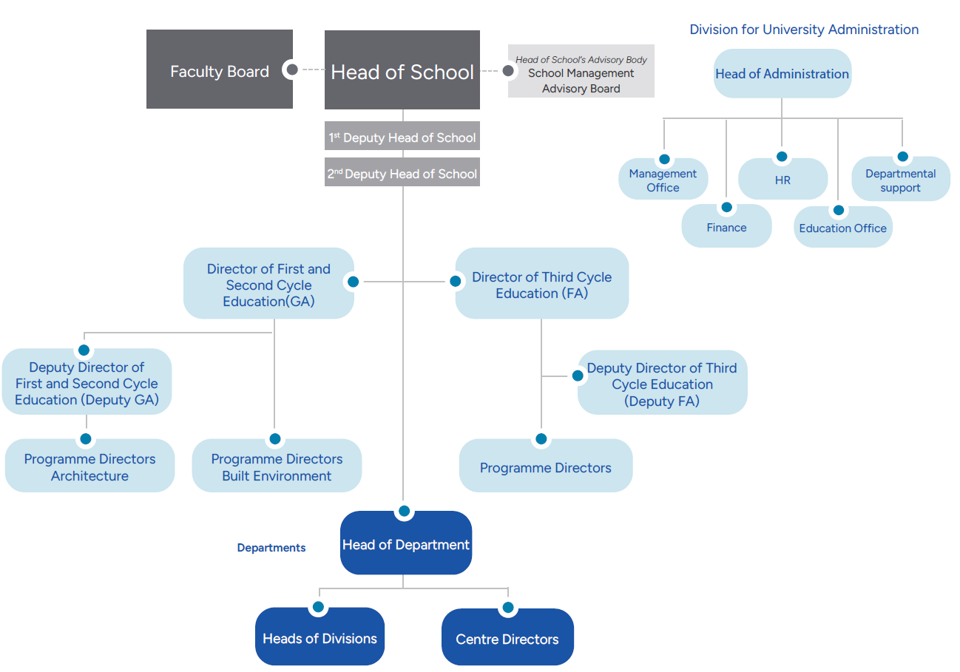
Organisation

