Slide 4
MSc XXX
Congratulations on your acceptance
and welcome to this gathering about
Notes:
Considering the event's purpose to offer a deeper understanding of the programme and early engagement with admitted students, these elements help in conveying the value and uniqueness of the programme effectively. Each component serves to inform, inspire, and address potential concerns, thereby enhancing students' confidence in their decision to join the programme at KTH.

Slide 5


Welcome and introduction
Programme director
xxx
Current programme student
xxx
Start with a welcome from all programme representatives joining. Introduce the structure of the session briefly. Including pictures of yourself can be nice as well.

Slide 6
Programme overview
Provide a detailed overview of the programme structure, courses offered, and any unique features that distinguish it. Feel free to add pictures to make it more clear.

Slide 7

Sustainable development
Talk about how your programme relates to the UN Sustainable Development Goals.

Slide 8
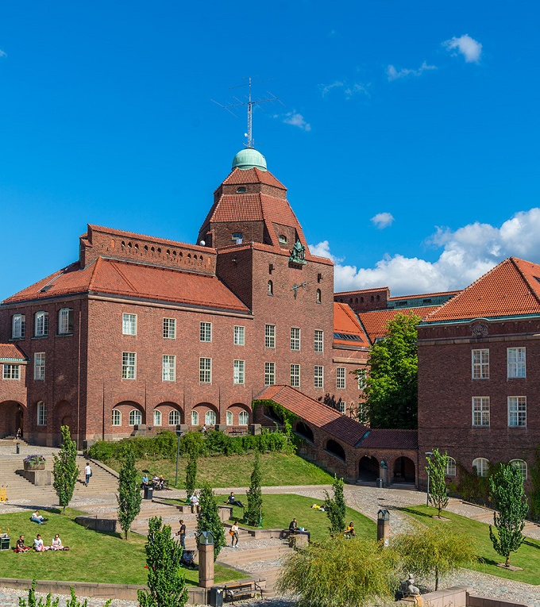
Degree project
Briefly outline the structure and expectations of the degree project or thesis. Emphasize the support available to students during this phase of their studies. What options are available for degree project? Give some examples.

Slide 9
Academic and
career opportunities
Discuss opportunities for research, internships, and collaborations within the programme. Highlight career prospects and success stories of graduates, demonstrating how the programme prepares students for their future careers.

Slide 10
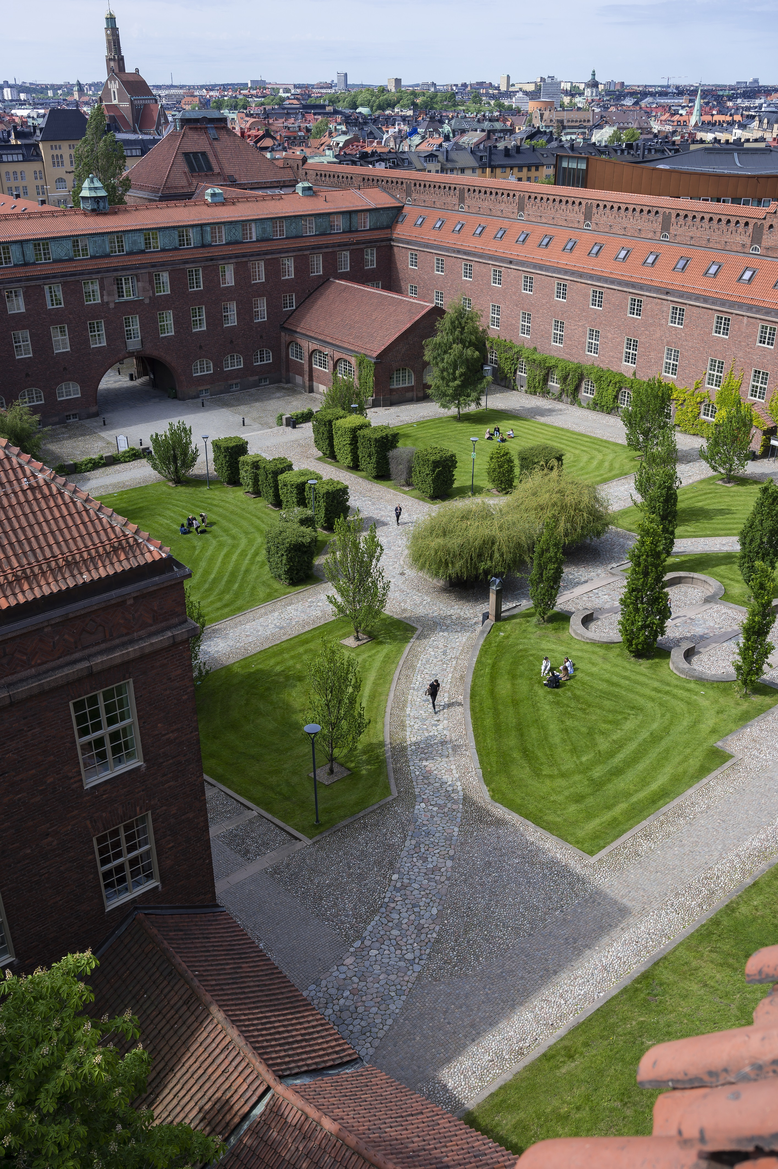
Advice and/or preparations
Students who feel prepared are less likely to struggle in the first months. Do you have any tips or tricks to help them prepare for the programme start? Have you seen any trends from previous years?
This should be related to the programme, as they receive the more general information in our other activities.

Slide 11
Student perspective
If a student joins, we suggest they have a slide or two and share their experience (preferably with pictures) of the programme and being a student at KTH.

Slide 12
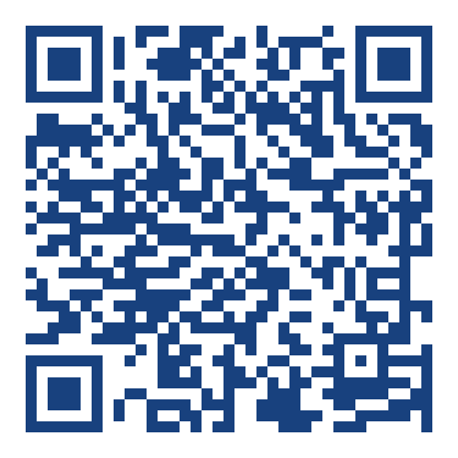

Goin’ Connect
SCAN TO JOIN
KTH’s digital student community
Connect with your future peers in your programme-specific group
Find more groups of your interests and link up with both newly admitted and current students
On your phone? Go to: https://register.goinconnect.com/university/71246
Notes:
Note: this slide does not need updates; it’s information you can provide to your programme-admitted students.
KTH's digital student community is an app powered by Goin' Connect. In the app, you can find a group specifically for this programme, so make sure to join and get to know each other before coming to Sweden! You can also find groups related to interests and hobbies and you can connect with both newly admitted and current students at KTH.
Joining is a great way of building a network, but it's also a place to raise questions and wonderings. You can find useful tips and tricks about being a student in Stockholm and at KTH. Additionally, you can find upcoming events and useful information about preparing for your move and how KTH can help you.
You should have received the registration link via email from us already. If you haven’t joined yet, scan the QR code or go to the link to register and join.
(All admitted students will use the same link. If someone is joining from their phone and can’t scan the link is: https://register.goinconnect.com/university/71246)

Slide 13
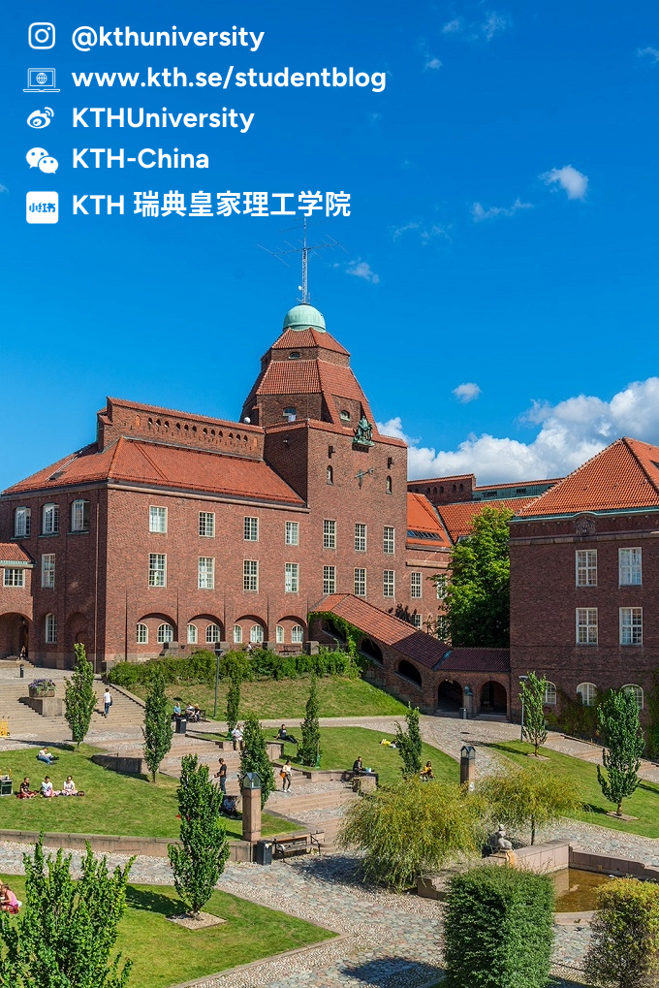
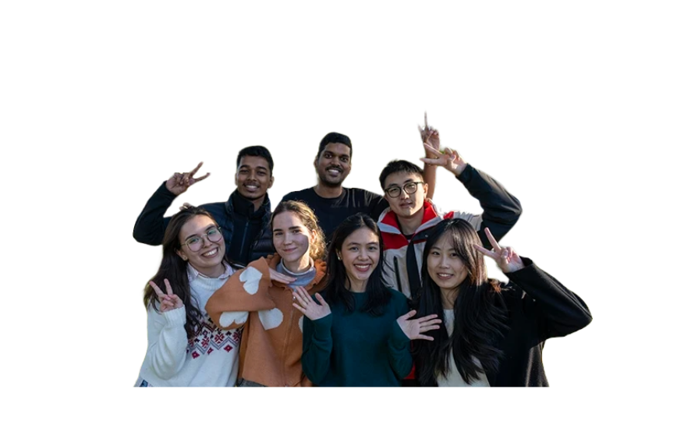
Events
Webinars
Admitted! Here’s What to Do Next – 3 April
Finding a Place to Stay – KTH edition – 15 April
Your KTH Arrival - 20 May
Regional networking events
Meet KTH staff and students from the region or country you come from, find more information on the website.
Notes:
Note: this slide does not need updates; it’s information you can provide to your programme-admitted students.
If you want to hear directly from current KTH students about their experiences, follow KTH on social media, including Instagram and WeChat.
Don't forget to join our other activities for admitted students, where you'll receive practical information to help you prepare for your start at KTH. If you missed any sessions, you can find the recordings on our website.

Slide 14
Questions
Open up the floor for questions. This should be related to the programme, as they receive more general information and practical preparations in our other activities.

Slide 15
Thank you!
See you on campus this fall ☺

