Slide 1
MSc XXX
Congratulations on your acceptance
and welcome to this gathering about
Notes:
Considering the event's purpose to offer a deeper understanding of the programme and early engagement with admitted students, these elements help in conveying the value and uniqueness of the programme effectively. Each component serves to inform, inspire, and address potential concerns, thereby enhancing students' confidence in their decision to join the programme at KTH.

Slide 2


Welcome and introduction
Programme director
xxx
Current programme student
xxx
Start with a welcome from all programme representatives joining. Introduce the structure of the session briefly. Including a picture of yourself can be nice as well.

Slide 3
Programme overview
Provide a detailed overview of the programme structure, courses offered, and any unique features that distinguish it. We know from surveys that the most important factor in their choice of KTH is the programme content, so this information is important. Feel free to add pictures to make it clearer.

Slide 4
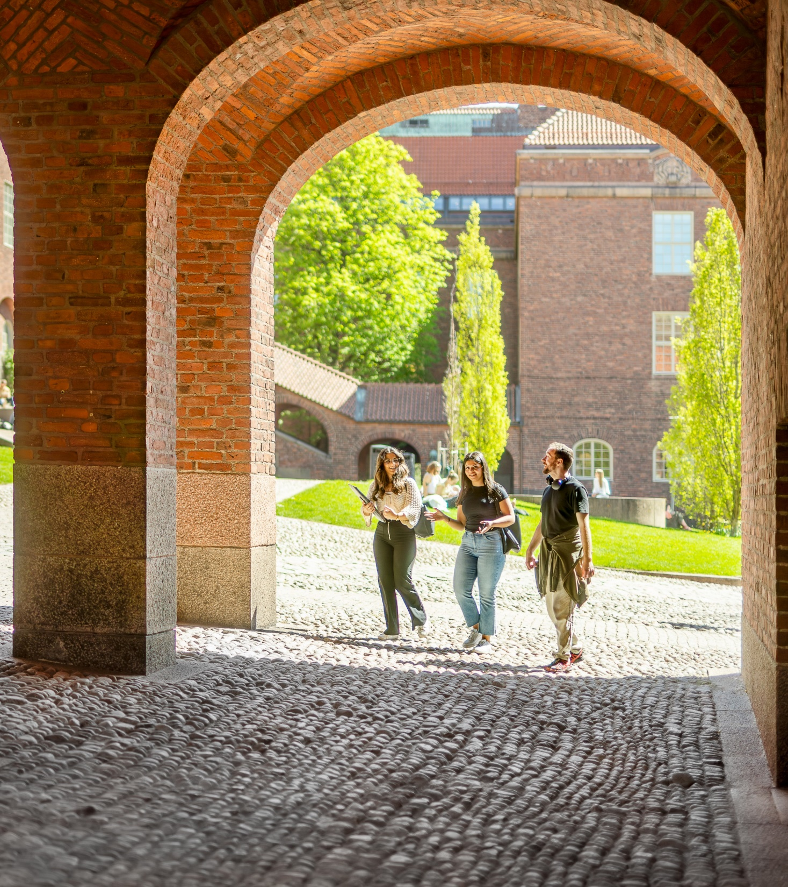
Degree project
Briefly outline the structure and expectations of the degree project or thesis. Emphasise the support available to students during this phase of their studies. What options are available for degree project? Give some examples.

Slide 5

Academic and
career opportunities
Discuss opportunities for research, internships, and collaborations within the programme. Highlight career prospects and success stories of graduates, demonstrating how the programme prepares students for their future careers.

Slide 6
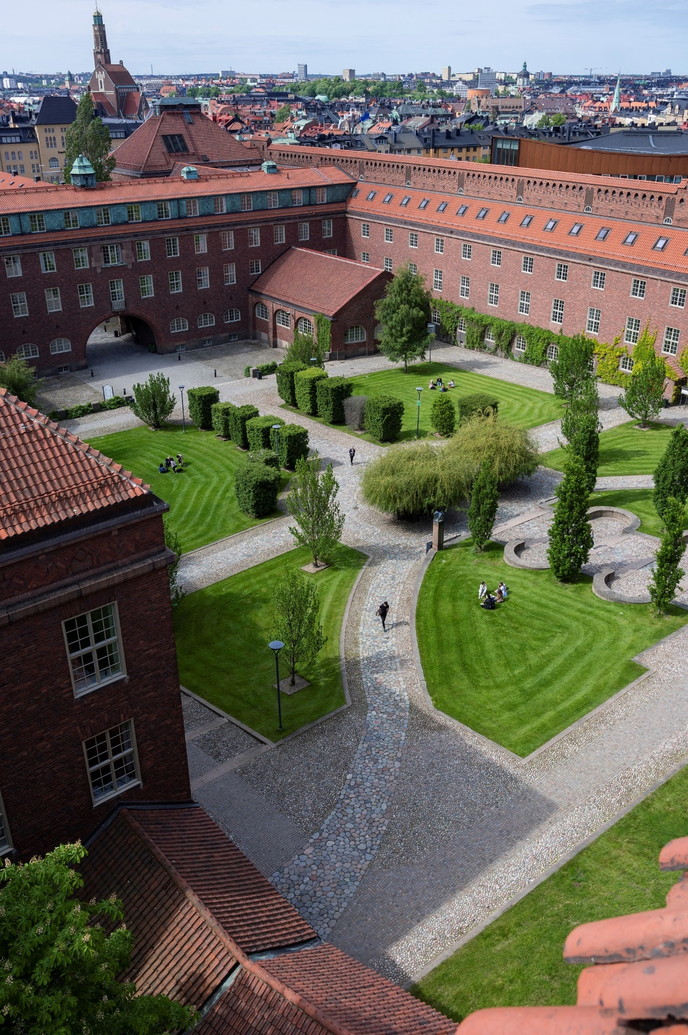
Advice and/or preparations
Students who feel prepared are less likely to struggle in the first months. Do you have any tips or tricks to help them prepare for the programme start? Have you seen any trends from previous years?
This should be related to the programme, as they receive the more general information in our other activities.

Slide 7
Student perspective
If a student joins, we suggest they have a slide or two and share their experience (preferably with pictures) of the programme and being a student at KTH.

Slide 8
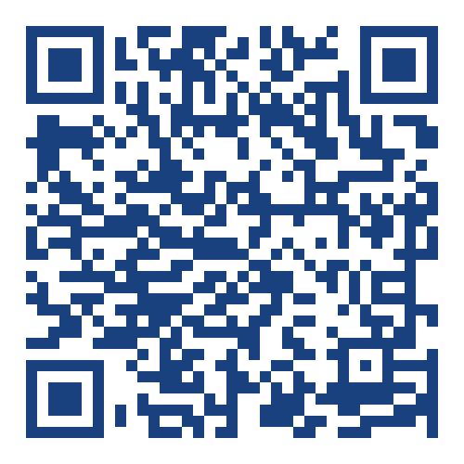



Goin’ Connect
SCAN TO JOIN
KTH’s digital student community
Connect with your future peers
Find various groups of interest (or start your own!) and link up with other newly admitted students
Or access via: https://register.goinconnect.com/university/17393
Notes:
Note: this slide does not need updates; it’s information you can provide to your programme-admitted students.
KTH's digital student community is an app powered by Goin' Connect. In the app, you can find a group specifically for this programme, so make sure to join and get to know each other before coming to Sweden! You can also find groups related to interests and hobbies and you can connect with both newly admitted and current students at KTH.
Joining is a great way of building a network, but it's also a place to raise questions and wonderings. You can find useful tips and tricks about being a student in Stockholm and at KTH. Additionally, you can find upcoming events and useful information about preparing for your move and how KTH can help you.
You should have received the registration link via email from us already. If you haven’t joined yet, scan the QR code or go to the link to register and join.
(All admitted students will use the same link. If someone is joining from their phone and can’t scan the link is: : https://register.goinconnect.com/university/17393)

Slide 9
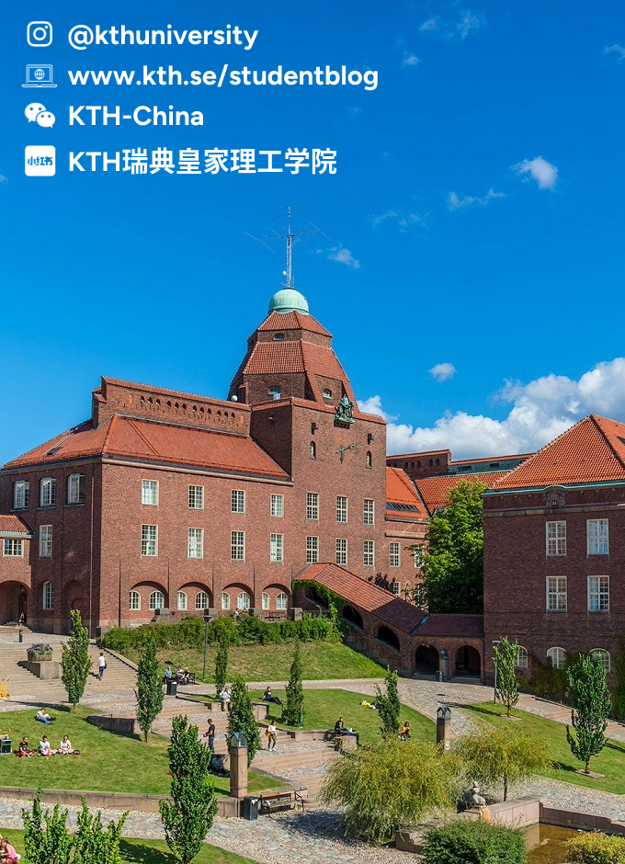
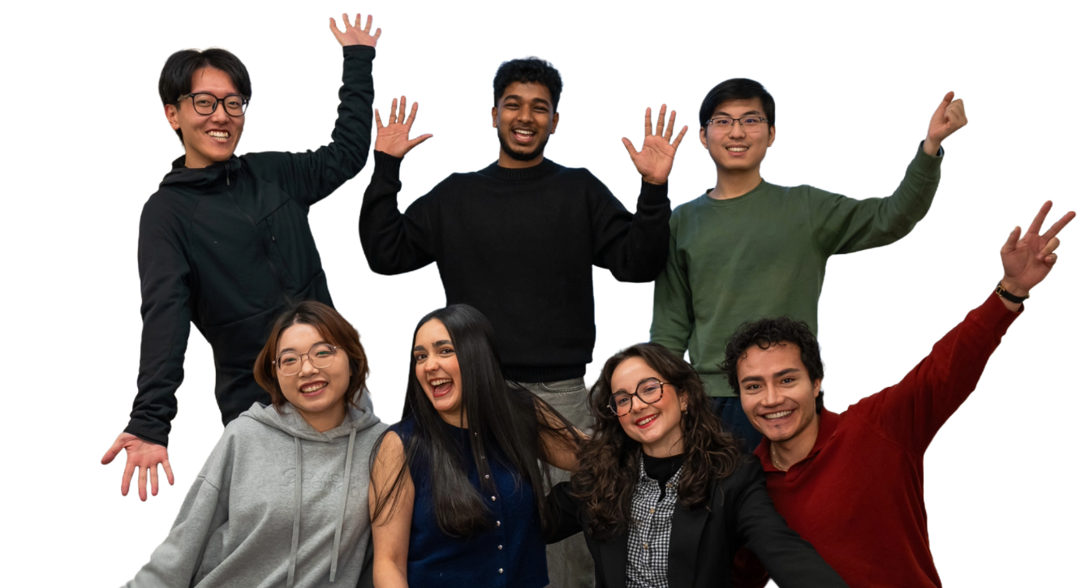
Events
Digital events
Admitted! Here’s What to Do Next – 30/3
KTH Housing Session – 23/4
Your KTH Arrival – 28/5
Review webinar recordings: kth.se/newatkth
Regional networking events
Meet KTH staff and students from the region or country you come from, find more information on the website.
Notes:
Note: this slide does not need updates; it’s information you can provide to your programme-admitted students.
If you want to hear directly from current KTH students about their experiences, follow KTH on social media, including Instagram and WeChat.
Don't forget to join our other activities for admitted students, where you'll receive practical information to help you prepare for your start at KTH. If you missed any sessions, you can find the recordings on our website.

Slide 10

Questions
Open up the floor for questions. This can be related solely to the programme, as they receive more general information and practical preparation in our other activities (you can refer these questions to the website, where they can find webinar recordings and more). The student ambassador can also help answering.

Slide 11
Thank you!
See you on campus this autumn ☺

