Slide 1
School of Engineering Sciences i Chemistry, Biotechnology and Health

Slide 2
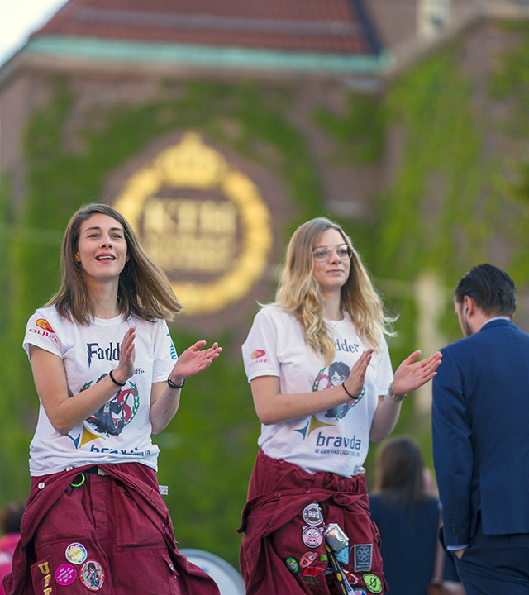
Sweden’s largest technical university
14,000 full-time students
1,700 postgraduate students
3,600 full-time equivalents
Three campuses in the Stockholm region
Notes:
KTH är Sveriges största tekniska universitet.

Slide 3
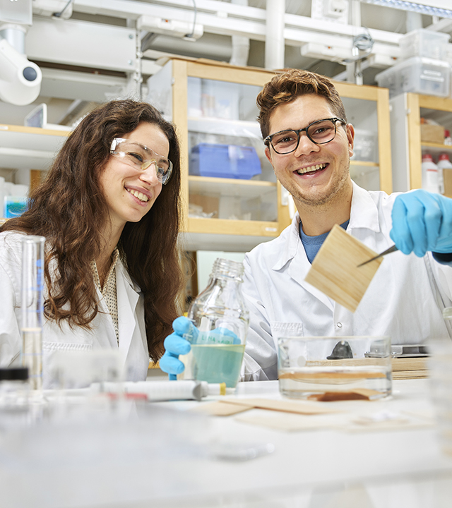
The School of Engineering Sciences in Chemistry, Biotechnology and Health
KTH’s second-largest school
2,400 full-time students
+300 postgraduate students
718 staff members
110 professors
36 associate professors
15 assistant professors
103 researchers
Four locations

Slide 4
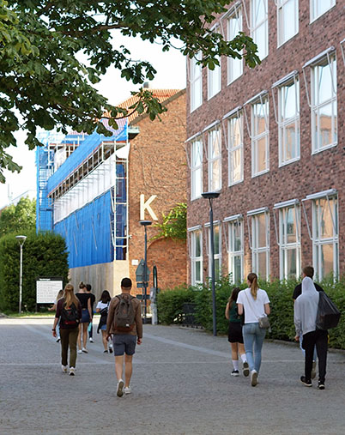
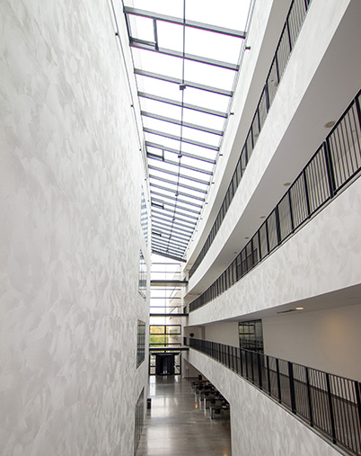

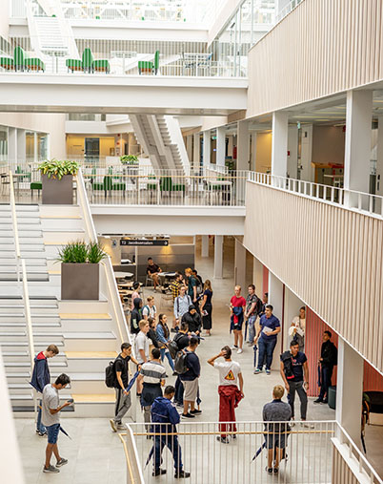
Research and education on four locations
KTH Campus
AlbaNova
KTH Solna
KTH Flemingsberg

Slide 5
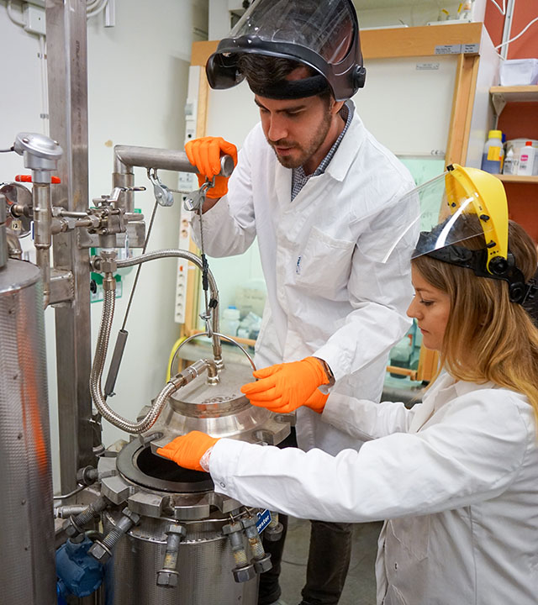
Research areas
Health
Materials
Energy
Environment

Slide 6
CBH’s organisation

Slide 7

Staff
65 professors
45 associate professors
18 assistant professors
37 lecturers
172 researchers and research engineers
237 doctoral students
107 technical and administrative staff

Slide 8
Economy and financing
The ten largest external funders
Approximately 1.36 billion kronor in turnover (including transfers)
External funding (41 %)
Grants for postgraduate education (27 %)
Grants for undergraduate education (17 %)
Other (15 %)
The Swedish Research Council (21%)
The Wallenberg Foundations (19%)
The EU (18%)
Vinnova (10%)
The Swedish Energy Agency (10%)
Formas (8%)
HPA’s Research Foundation (5%)
The Foundation for Strategic Research (5%)
The Novo Nordisk Foundation (2%)
The Swedish Cancer Society (2%)

Slide 9
Education

Slide 10
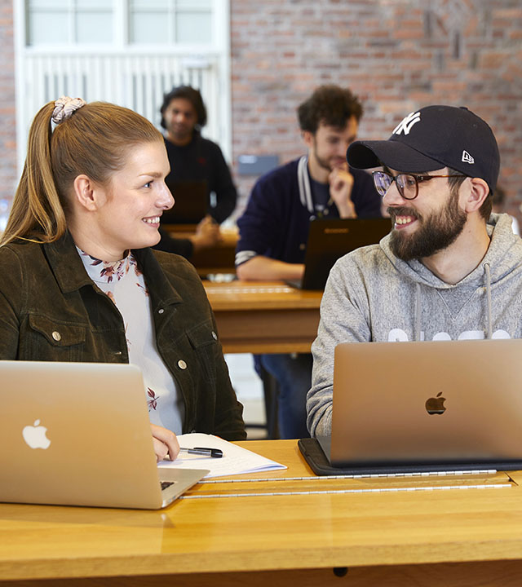
Foundation year programme
Qualifies you to apply for KTH’s engineering programmes.
Study skills for the future.
The opportunity to apply for a reserved place at KTH upon completion of your studies.

Slide 11
Bachelor of Science in Engineering
Master of Science in Engineering
Computer Science – Systems Development and Digital Infrastructure 180 hp
Electrical Engineering 180 hp
Chemical Engineering 180 hp
Medical Technology 180 hp
Engineering and Economics 180 hp
Biotechnology 300 hp
Medical Technology 300 hp
Engineering Chemistry 300 hp

Slide 12

International Master’s programmes
Chemical Engineering for Energy
and Environment
Data-driven Health
Industrial and Environmental Biotechnology
Macromolecular Materials
Medical Biotechnology
Medical Engineering
Molecular Science and Engineering
Molecular Techniques in Life Science
Sports Technology
Technology, Work and Health
Molecular Biotechnology and Bioinformatics

Slide 13
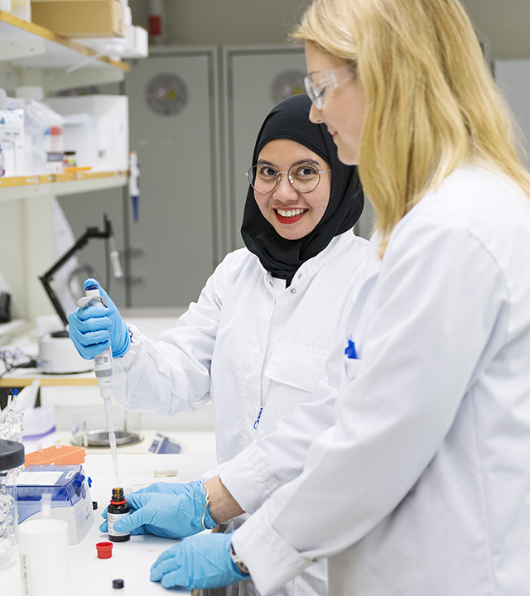
Doctoral programmes
Biotechnology
Chemical Science and Engineering
Medical Technology
Technology and Health

Slide 14

Global challenges
Sustainable energy
Health and an ageing population
Climate change
Sustainable production and working life
Food production
Clean water

Slide 15
Research

Slide 16

Research Centres
2MILab
ACCELERATE
AdBIOPRO
AIMES
[A.C.T.I.V.E.] Space
Batteries Sweden (BASE)
CellNova
CEM4MAT
Centre for Data Driven Health (CDDH)
GeneNova
Greenhouse Labs
Human Protein Atlas
Integration Lab
Notes:
KI är huvudman för AIMEs. Uppsala universitet är huvudman för BASE.

Slide 17

Research Centres
Jonasson Centre for Medical Imaging
KTH Centre for Sports Technology
KTH FOOD
MedTechLabs
National Genomics Infrastructure (NGI)
Treesearch
Wallenberg Center for Protein Research (WCPR)
Wallenberg Wood Science Center (WWSC)
National Nuclear Magnetic Resonance Infrastructure (SwedNMR)
Notes:
KTH FOOD forskar på framtidens mat. En ökad användning av kulturspannmål har fördelar för både hälsan och planeten. På bilden ser vi äldre vetesorter, som emmer och spelt.

Slide 18
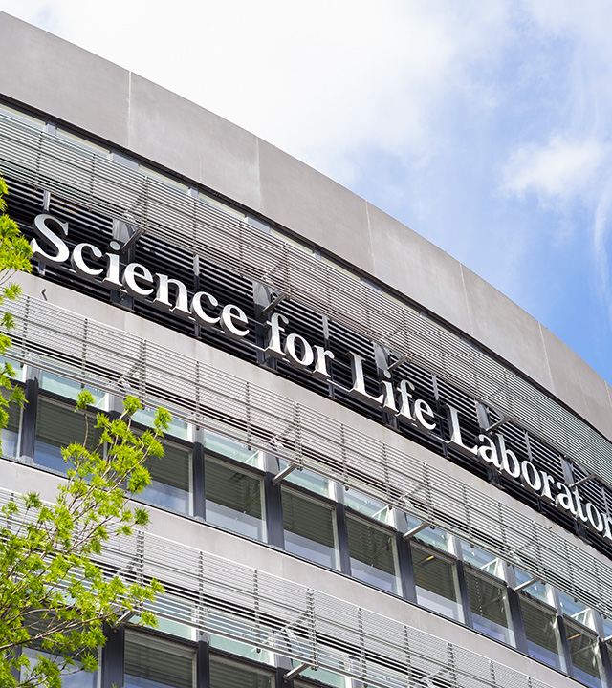
SciLifeLab
National Centre for Molecular Biosciences.
Research in health and the environment.
Leading technical expertise with advanced knowledge in translational medicine and molecular biosciences.
Run in collaboration with Karolinska Institutet, Stockholm University and Uppsala University.

