Slide 1
Read me
This presentation serves as a template and inspiration for introducing your master’s programme to prospective students. The suggested agenda consists of areas we know from surveys the target group are highly interested in and key factors why they end up choosing KTH.
We would like to showcase more teaching facilities and/or relevant labs like the pictures in this presentation, on the programme pages. If you have ideas or suggestions, please get in touch with us
A few things to keep in mind:
The presentation should preferably be around 20-35 min
Include the latest numbers, statistics and rankings (if used)
Use pictures that align with the programme or general KTH pictures, of good quality
Always have a prospective student mindset
  Easy-followed information
  Keep things interesting (too detailed information could potentially be left out)
  Prospective students´ perspective on information
ISR is always at your disposal, from content to visuals (ex. you could add the info, and we put it together nicely) – contact Julia Hahrs ☺

Slide 2
MSc Macromolecular Materials

Slide 3

MSc Macromolecular Materials
Programme director:
Name, email, designation
Student ambassador:
Name, country, year in programme
Notes:
Participants: List the name and titles of the participants, preferably with a photo

Slide 4
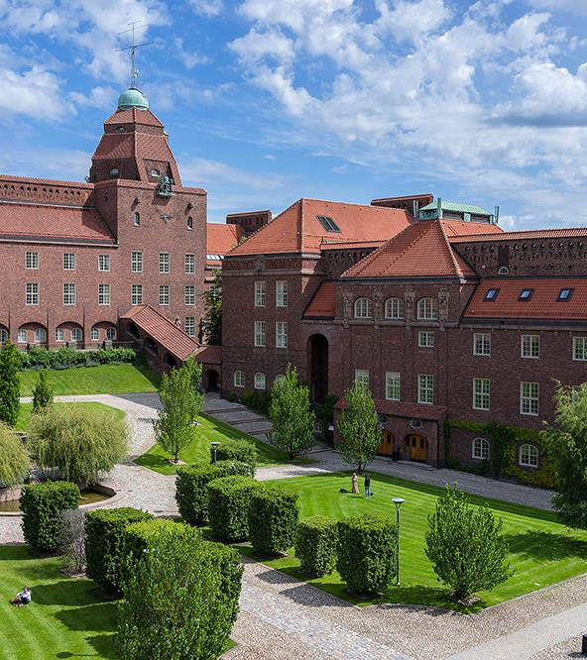
Agenda
About the programme
  Courses /Tracks
  Entry requirements
SDGs
Degree project
Connection to industry
Research
Career
Notes:
Present the agenda of the presentation

Slide 5
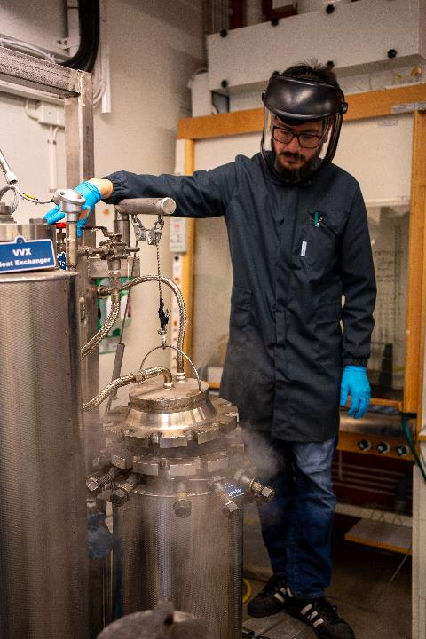
About the programme
Provides the skillset to lead the development of future sustainable fibre and polymer-based materials. Our courses let you specialise in pulp and paper technology, advanced health care, energy production, bio-based composites, surface coatings and circular materials.
Notes:
Introduce the programme. What is the focus and aim? What are the unique selling points? Mention people/other institutions/companies involved if relevant. Practical, hands-on learning? Problem-solving and teamwork?
Preferably use picture that align with your programme or general KTH pictures

Slide 6
Courses: year 1
Conditionally elective courses
Polymer Materials in a Circular Economy (CK2180) 7.5 credits
Polymeric Materials: Structure and Properties (KF2190) 7.5 credits
Chemistry of a Biorefinery (KF2480) 7.5 credits
Recommended courses
Glycobiotechnology (BB2425) 7.5 credits
Biocatalysis (BB2460) 7.5 credits
Organic Chemistry, Basic Concepts and Practice 2 (KD1270) 7.5 credits
Solid State Chemistry: Structures and Methods (KD2155) 7.5 credits
Nanostructured Materials (KD2170) 7.5 credits
Ideation- Creating Your Own Company (ME2814) 7.5 credits
Mandatory courses
Scientific Methodology and Research Horizons (CK2030) 7.5 credits
Mechanical Properties of Materials (KF2110) 7.5 credits
Polymer Chemistry (KF2130) 7.5 credits
Polymer Physics (KF2140) 7.5 credits
Fibre Technology - Natural and Synthetic Fibres (KF2450) 7.5 credits
Bio Fibre Chemistry (KF2460) 7.5 credits
Notes:
Outline the programme structure, highlight courses and/or tracks (ex do they choose tracks when they apply or later? How should they think when they choose track)
In this slide you can introduce the various courses and / or tracks within the programme

Slide 7
Courses: year 2
Conditionally elective courses
Surfaces, Colloids and Soft Matter (KD2350) 7.5 credits
Surface Coatings Chemistry (KF2150) 7.5 credits
Pulp and Paper Processes (KF2470) 7.5 credits
Polymer Composites - Micro and Nanoscale (KF2495) 7.5 credits
Polymer Materials Processing (KF2505) 7.5 credits
Recommended courses
Molecular Enzymology (BB2020) 7.5 credits
Advanced Organic Chemistry (CK2310) 7.5 credits
Biomedical Materials (KD2300) 7.5 credits
Spectroscopic Tools for Chemistry (KD2320) 9.0 credits
Corrosion and Surface Protection (KD2380) 7.5 credits
Risk Analysis and Management for Chemical Engineers (KE2351) 7.5 credits
Consists of courses and a mandatory degree project.
Mandatory courses
Degree Project in Fibre and Polymer Technology, Second Cycle (KF200X) 30.0 credits
Notes:
Outline the programme structure, highlight courses and/or tracks (ex do they choose tracks when they apply or later? How should they think when they choose track). How should students think choosing elective vs recommended courses etc.

Slide 8
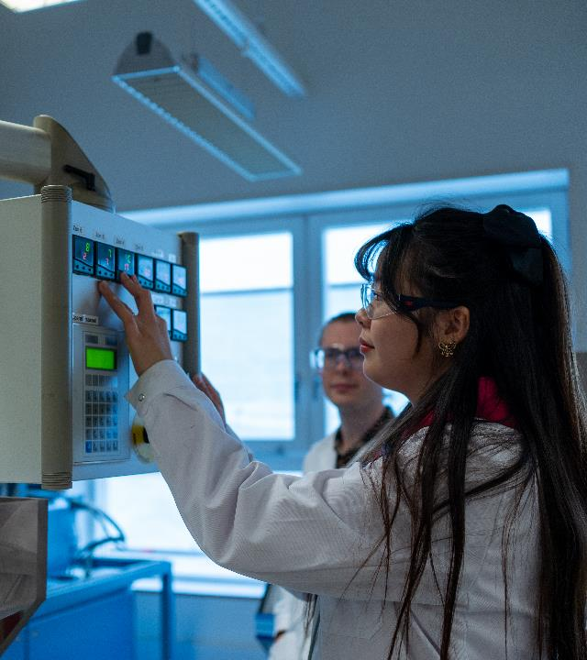
Entry requirements and documents
Requriments
Bachelor's degree (final year students qualify)
English proficiency
Programme-specific requirements
Programme-specific documents
CV
Letter of recommendation and/or motivation
Summary sheet
Any other document needed
Notes:
Highlight the requirements for the programme and the programme-specific documents you require. How do students submit a strong application, clarify things that you may have received questions about previously, emphasise/explain summary sheet or any other programme-specific document

Slide 9
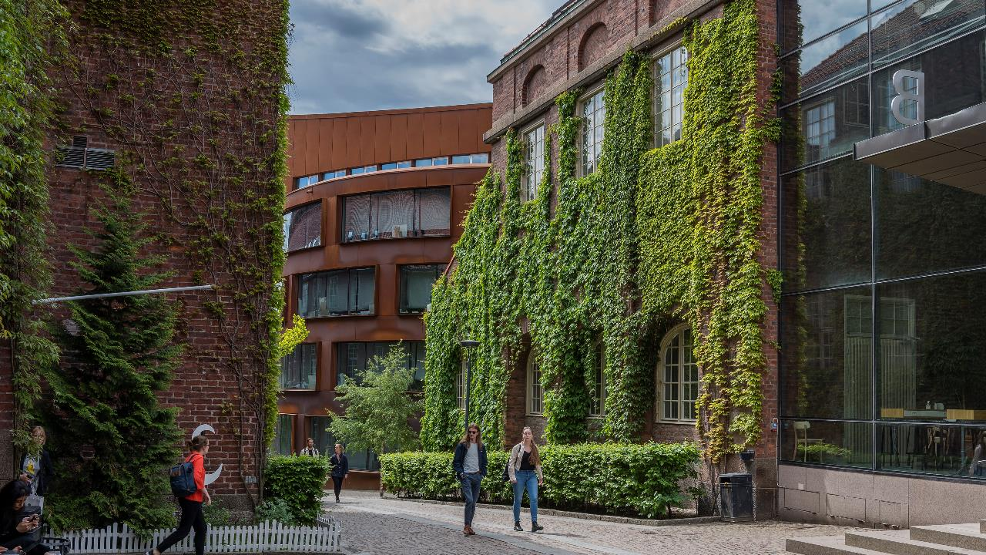

Sustainable development
Notes:
Talk about how your programme relates to the UN Sustainable Development Goals and how it possibly tackles certain global issues.

Slide 10
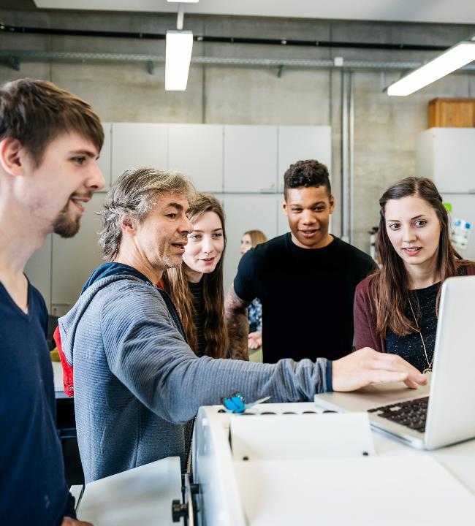
Degree project
Topics previously explored include:
Life-time predictions of commodity plastics
Design of biobased adhesives
Synthesis of sustainable polymers
Fibre-solution interactions
And more!
Notes:
What options are available for a degree project? Give some examples. How do students find companies to do the project with, if they’d like?

Slide 11
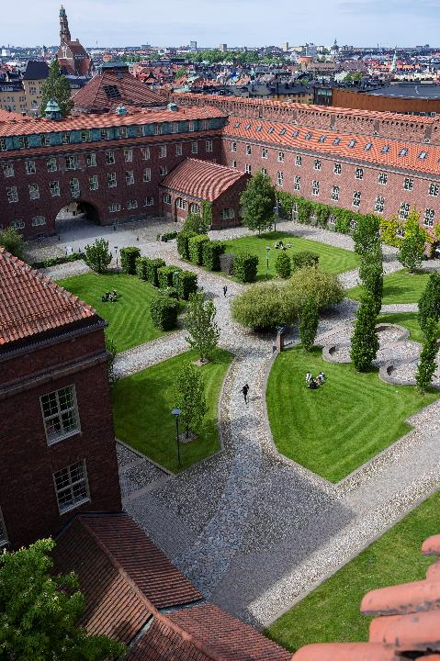
Connection to industry
Collaboration with companies
Adjunct professors
Visits
etc
Notes:
How do the programme connect to the industry? In collaboration with companies, adjunct professors, vistis etc?

Slide 12
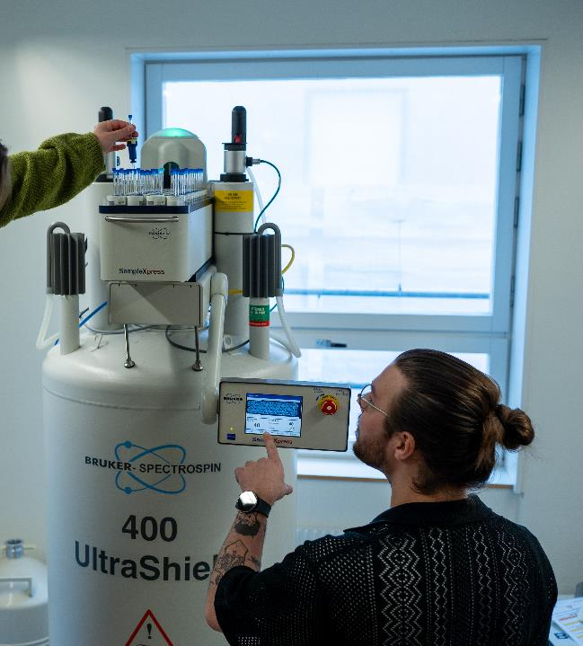
Research
The programme establishes excellent laboratory skills and is closely linked to research at the Department of Fibre and Polymer Technology.
Notes:
What research is conducted in connection to your programme? Give some examples. It's important to hightlight how/if students can get involved as it's probably what the audience can relate most to at this stage.

Slide 13
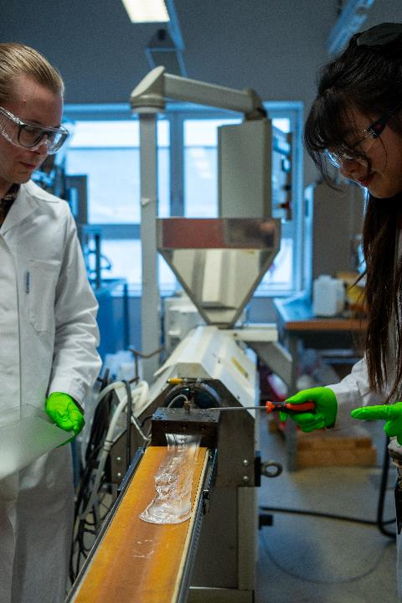


Future career
57 %
97 %
gets a first job offer before graduating
Secure a job within 2 years
International
degree
Early connection with the industry
Notes:
What can students do after graduating? Phd, industry. Give some examples of companies and industries to work within or do research on.
Any programme-specific statistics on the number of students finding a job after graduating (to numbers on the slides are numbers for all students at KTH)

Slide 14
Student perspective
If a student joins, we suggest they have a slide or two and share their experience (preferably with pictures) of the programme and being a student at KTH. It’s good to incorporate the student’s slides in the existing presentation to make it easy when presenting.

Slide 15
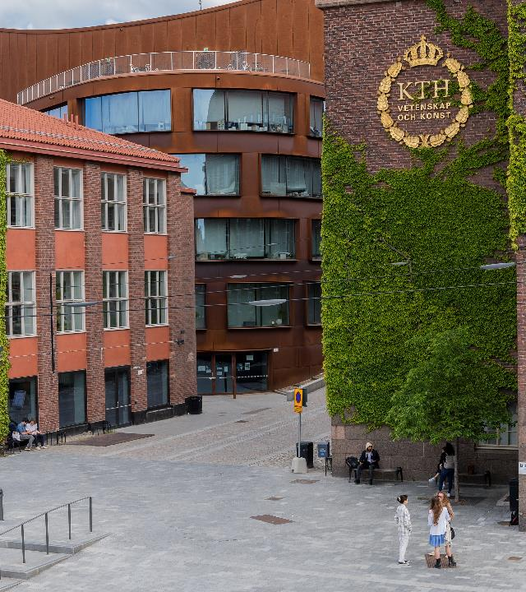
Questions?
Contact details:
Name and email
Notes:
Open up for the audience to ask questions and share contact details
Mention that the application period is open, closing in mid-January.

