Slide 1
Read me
This presentation serves as a template and inspiration for introducing your master’s programme to prospective students. The suggested agenda consists of areas we know from surveys that the target group is highly interested in, as well as key factors that lead them to choose KTH. Please add/change anything you would like to tailor it to your specific programme.
We would like to showcase more teaching facilities and/or relevant labs like the pictures in this presentation, on the programme pages. If you have ideas or suggestions, please get in touch with us
A few things to keep in mind:
The presentation should preferably be around 20-35 min
Include the latest numbers, statistics and rankings (if used)
Use pictures that align with the programme or general KTH pictures, of good quality (or keep the ones in this presentation)
Try having a prospective student mindset
  Easy-to-follow information
  Keep things interesting (too detailed information could potentially be left out)
  Prospective students´ perspective on information
We are always at your disposal, from content to visuals (ex. you could add the info, and we put it together nicely).
Contact Julia Hahrs ☺

Slide 2
MSc Scalable Computing Systems

Slide 3
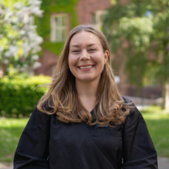
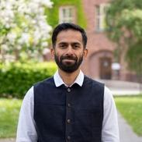
MSc Scalable Computing Systems
Programme director:
Name, email, designation
Student ambassador:
Name, country, year in programme
Notes:
Participants: List the name and titles of the participants, preferably with a photo

Slide 4
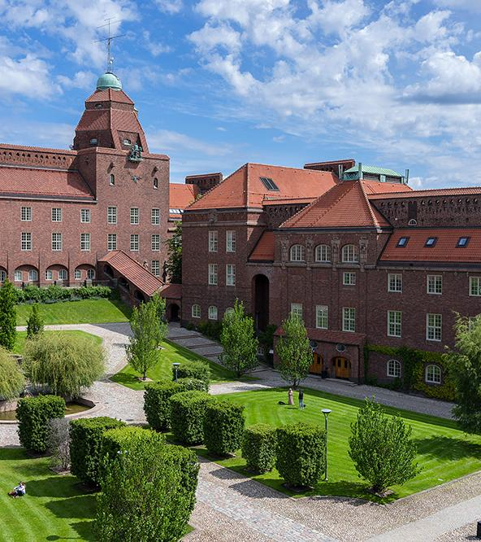
Agenda
About the programme
  Courses /Tracks
  Entry requirements
SDGs
Degree project
Connection to industry and research
Career after KTH
Notes:
Present the agenda of the presentation

Slide 5

About the programme
Focuses on the systems that power modern AI and digital services. Learn to design, build and operate distributed data systems, cloud platforms and computing infrastructure for large-scale applications.
The programme has three tracks:
AI Computing System
Trustworthy Systems
Networked Systems
Notes:
Introduce the programme. What is the focus and aim? What are the unique selling points? Mention people/other institutions/companies involved if relevant. Practical, hands-on learning? Problem-solving and teamwork? Acceptance rate last year?
Preferably use picture that align with your programme or general KTH pictures.
If you want, you can also add rankings resonating with your programme (the overall ranking of KTH, we usually mention in our broader events, but feel free to use those as well: Ranking for KTH | KTH)

Slide 6

Courses: year 1
Mandatory courses for all tracks
Fundamentals of Communications (New course) 7.5 ECTS credits
Fundamentals of Systems (New course) 7.5 ECTS credits
Program Integrating Course (New course) 3 ECTS credits
Recommended course
Programmable Society with Blockchains and Smart Contracts (DD2585) 7.5 ECTS credits
Mandatory, conditionally elective and recommended courses then depend on the track you choose. Examples are:
AI Computing System
Networked Systems for Machine Learning (IK2221) 7.5 ECTS credits
Data Mining (ID2222) 7.5 ECTS credits
Trustworthy Systems
Advanced Distributed Systems (ID2203) 7.5 ECTS credits
Compilers and Execution Environments (ID2202) 7.5 ECTS credits
Networked Systems
Queuing Theory (EP2200) 7.5 ECTS credits
Networked Systems for Machine Learning (IK2221) 7.5 ECTS credits
Notes:
Outline the programme structure, highlight courses and/or tracks (ex do they choose tracks when they apply or later? How should they think when they choose track)
In this slide you can introduce the various courses and / or tracks within the programme

Slide 7

Courses: year 2
Mandatory courses for all tracks
Research Methodology and Scientific Writing (II2202) 7.5 ECTS credits
Project course (New course) 7.5 ECTS credits
Degree project, 30 ECTS credits
Mandatory, conditionally elective and recommended courses then depend on the track you choose. Examples are:
AI Computing System
Networked Systems for Machine Learning (IK2221) 7.5 ECTS credits
Machine Learning (DD2421) 7.5 ECTS credits
Trustworthy Systems
Automated Software Testing and DevOps (DD2482) 7.5 ECTS credits
Network Analytics (EP2420) 7.5 ECTS credits
Networked Systems
Non-Terrestrial Networks (New course) 7.5 ECTS credits
Digital Communications (New course) 7.5 ECTS credits
Notes:
Outline the programme structure, highlight courses and/or tracks (ex do they choose tracks when they apply or later? How should they think when they choose track). How should students think choosing elective vs recommended courses etc.

Slide 8
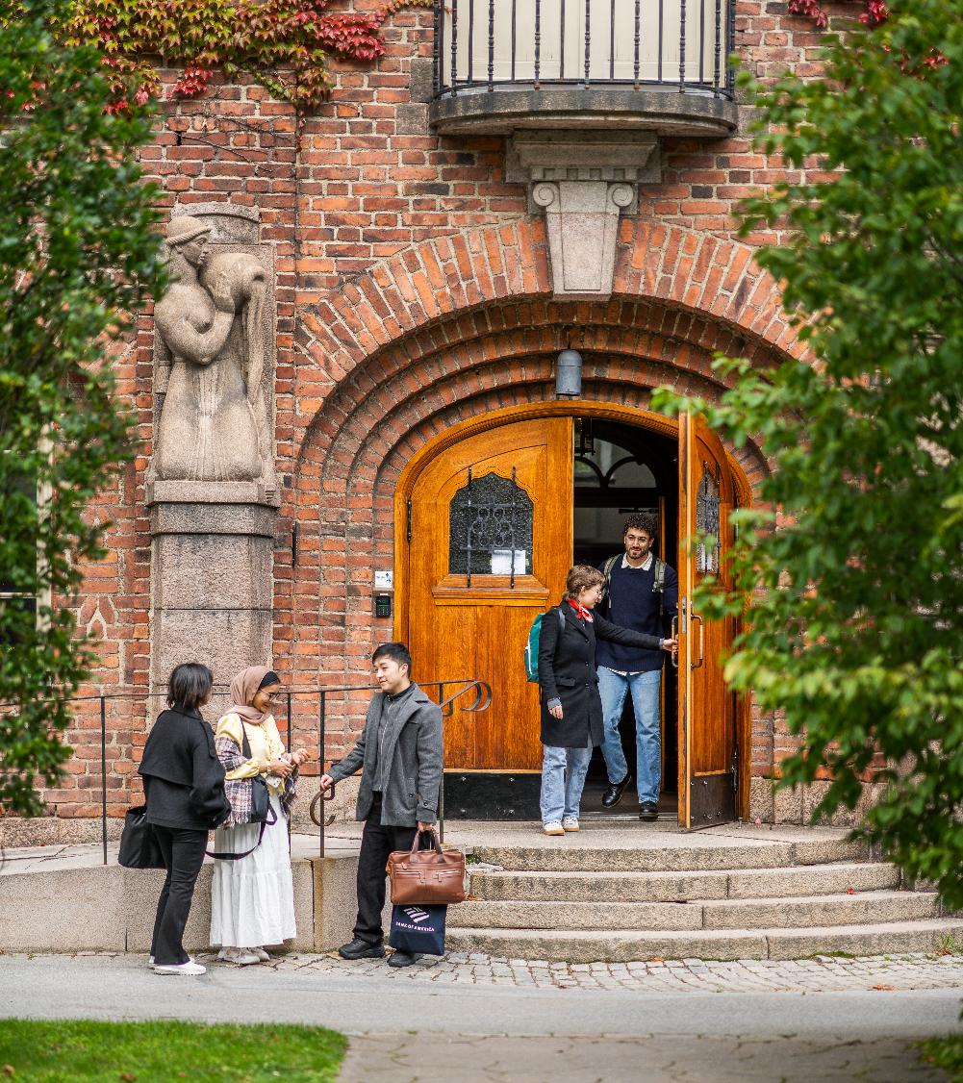
Entry requirements and documents
General requirements
Bachelor's degree equivalent to a Swedish bachelor's degree
English proficiency
Programme requirements
Xxx credits in xxx
Xxx credits in yyy
Programme-specific documents
CV
Letter of recommendation and/or motivation
Summary sheet
Any other document needed
Notes:
Highlight the requirements for the programme and the programme-specific documents you require. How do students submit a strong application, clarify things that you may have received questions about previously, emphasise/explain summary sheet or any other programme-specific document

Slide 9
Fees
How to apply
Non-EU/EEA/Swiss citizens are generally required to pay application and tuition fees
  Application fee of SEK 900 (approximately € 80)
  Tuition fee for this 2-year programme xxx xxx SEK (approximately € xx xxx)
Scholarships are available from KTH and other external organisations
Choose your programmes
Check the admission requirements
Apply at universityadmissions.se
16 October to 15 January
Submit documents
1 February
Pay the application fee
1 February
Check the admission results
1 April
Notes:
This slide is optional (as they receive general information like this from our other activities). If you choose to use it, make sure it’s updated with the correct number every semester.

Slide 10
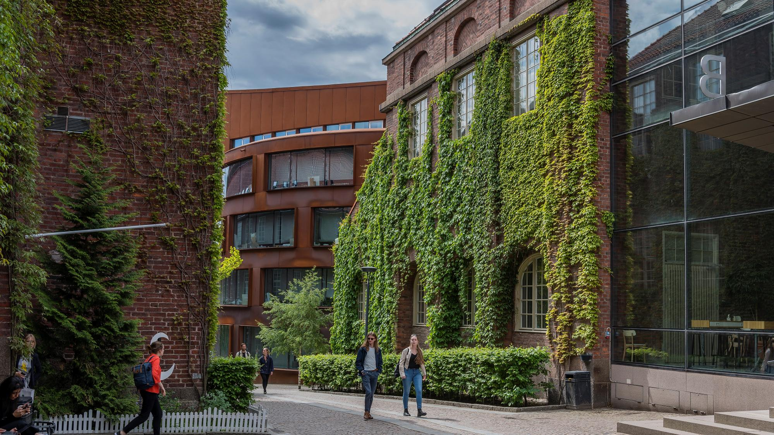



Sustainable development
Notes:
Talk about how your programme relates to the UN Sustainable Development Goals and how it possibly tackles certain global issues.
Pictures of goals can be fetched from the programme page

Slide 11

Degree project
Topics previously explored include:
Scalable systems for AI workloads
Cloud and distributed computing
GPU and accelerator-based computing
Large-scale data processing
Trustworthy and resilient systems
And more!
Notes:
What options are available for a degree project? Give some examples. How do students find companies to do the project with, if they’d like?

Slide 12
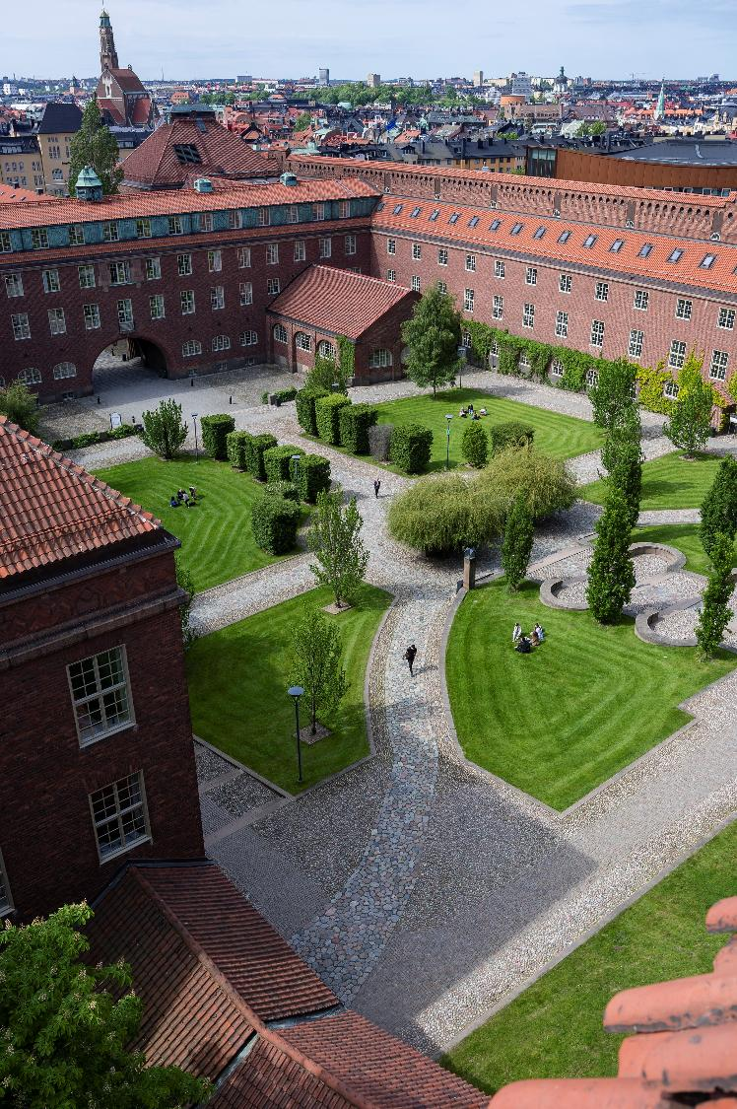
Connection to industry
Collaboration with companies
Adjunct professors
Visits from or to companies and organisations
etc
Notes:
How do the programme connect to the industry? In collaboration with companies, adjunct professors, vistis etc?

Slide 13

Research
The programme is developed within a research environment that includes leading researchers in scalable computing and distributed systems.
Notes:
What research is conducted in connection to your programme? Give some examples. It's important to hightlight how/if students can get involved as it's probably what the audience can relate most to at this stage.

Slide 14

Future career
International
degree
Study projects addressing
real societal issues
1,000-degree project proposals from companies
Early connection with the industry
Notes:
What can students do after graduating? Phd, industry. Give some examples of companies and industries to work within or do research on.
Any programme-specific statistics on the number of students finding a job after graduating (to numbers on the slides are numbers for all students at KTH)

Slide 15
Student perspective
If a student joins, we suggest they have one or two slides about their experience of the programme and student life at KTH here. Adding these to the existing presentation is a good idea to make it smoother.
We are coordinating the students’ presentations, so they should have them ready if you ask them ☺

Slide 16

Questions?
Contact details:
Name and email
Notes:
Open up for the audience to ask questions and share contact details
Mention that the application period is open, closing in mid-January.

Slide 17
Thank you!

