Slide 1
Taxi regulation in a modern society
Amy Rader Olsson
Special Investigator, Taxi and car sharing
20160927

Slide 2
The Swedish taxi market
About 16000 taxis in Sweden
One-man companies 4.351 –especially in the countryside
73 companies with more than 20 cars
Largest has 191 cars
One third of drivers over 56 years old

Slide 3
Deregulation and re-regulation
Deregulation 1990-now one of the world’s least regulated taxi markets
Free pricing
No limits to supply
Relatively low costs of entry: taxi driver license, operators license
Deregulation led to rapid increases in supply and oversupply, now stabilizing
Oversupply in larger cities, undersupply in rural areas
Function-bundling for the taxi meter (total km, paid km, resting times, transactions, (routes)

Slide 4
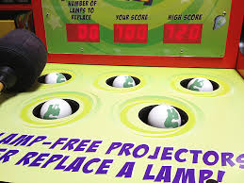
Regulatory whack-a-mole

Slide 5
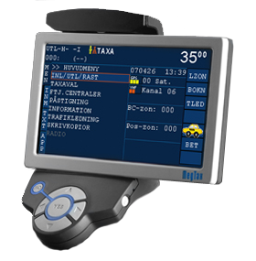
Re-regulation
Policy response to effects of deregulation has been to rely on reporting demands
Taxi meter
Taxi reporting centers (redovisningscentraler)
+ individual company requirements

Slide 6
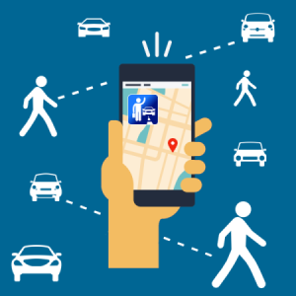
New sharing phenomena
Car sharing, car pooling, ride sharing, ride sourcing, taxi motorcycles, boat taxi, three wheeled taxi…everybody’s private driver, sharing economy, gig economy, work when you want, return to piecework….?

Slide 7
Changes in global and Swedish society
Fewer full time jobs
Underemployed
Flexibility demanded by both labor and customers
Challenges to the modern welfare state
Structural demographic change, spatial effects
ICT, IoT
Technology friendly society/generation/cities
Popular test market
Everybody is an entrepreneur?
Driverless cars….

Slide 8
Directive N2015:05
No exemption from taxi meter?
New category without taxi meter requirement?
What is ridesharing/carpooling?

Slide 9
Policy levers
Technologies-design or performance standards? Incentives?
Changes in structure, reporting requirements, tax levels..
Policies that inhibit, incentivize, let it happen..
In general, the taxi meter and taxi policy have co-evolved
Much focus on the taxi meter, not enough on contractual and responsibility relationship between customer, ordering platform, taxi company, tax authority, police, transport authority…

Slide 10
Alternative control instruments?
Mobile cash registers
On-board computers
ISA variations?
Tachometers
Future: server-based solutions that do not require physical securing in the car? Block-chain innovations for tamper-proof data collection and storage?

Slide 11
What is the difference between taxi and ridesharing?
Ridesharing among friends
Ridesharing through platform
Traditional taxi
Private driver-unlicensed
Notice-board ridesharing
Private driver-licensed
Ridesharing for a little profit

Slide 12
conclusions
The taxi meter is used less and less to calculate price, more and more to follow transactions (legal, illegal)
Multiple functionality—a hinder to innovation?
Challenge of technological neutrality
Difficulty in predicting effects in rapidly changing markets

Slide 13
vision
Everyone is an entrepreneur with a cash register?
Server-based, inexpensive technologies that can be used across sectors?
Horizontal and vertical links-across sectors, levels, space
Policies that establish clear responsiblities, reporting requirements
More efficient use of all resources—even human
Fair competition

Slide 14
Discussion questions
Technology futures?
Balance of functionality requirements?
Fair carsharing—support what’s good, discourage what’s not?
Sweden’s strategic stance in the EU on taxi, carsharing issues?
Other..?

