Slide 1





Research and education
for a brighter tomorrow

Slide 2
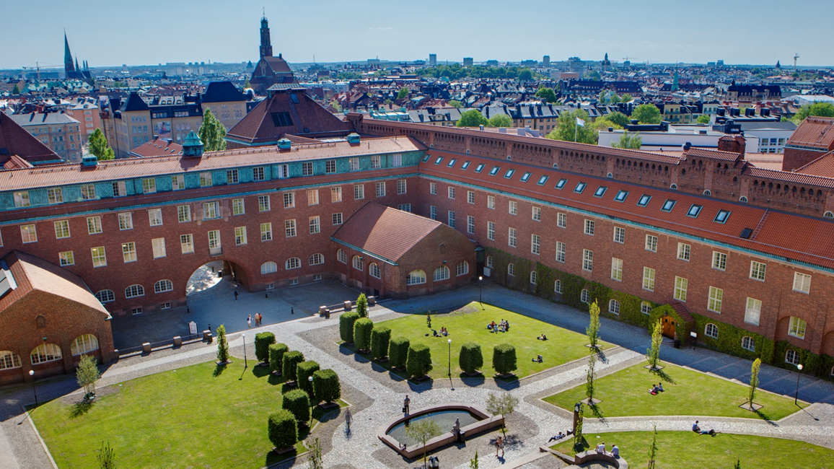

Notes:
This slide contains a link to a film about KTH. Please observe that internet access is needed to show the film.
Direct link to the film: https://youtu.be/Sn2hApKmApI

Slide 3
Sweden’s largest technical university
  17 000
  students
  4 000
  staff (FTE)
100 000
alumni in 100 countries
  35%
  women
  2 300
  international
  339
  professors
  2 800
  staff within research
  1 700
  doctoral students
  20
  international alumni associations
Notes:
KTH is the largest and oldest technical university in Sweden:
Founded in 1827
KTH has:
Students
Circa 17 000 students of which:
- More than a third (35%) are women and 2 300 are international
- 13,600 are full time equivalent students (FTE)
Staff
4000 staff (FTE- full-time equivalent) of which:
Circa 2,800 staff within research which includes
- 329 professors
-1,700 doctoral students
Alumni
Over 100,000 alumni in over 100 countries
More than 20,000 alumni live abroad
20 international alumni associations
Figures from 2022 annual report
Total number of peer reviewed scientific publications 3,140
Source: LinkedIn, HR+, Ladok
Anders Söderholm is the President of KTH since December 1, 2022. He previously served as the Director-General of the Swedish Higher Education Authority, UKÄ, for five years before joining KTH.
Anders Söderholm has held a range of different positions in the academic sector. His academic background is from Umeå University where he became a PhD in 1991 with a thesis on municipal industrial policies. He has been a professor of Business Administration and researcher and teacher in industrial economics at KTH in 1998-99 and 2003-2004.
As President, one of his goals is that KTH should continue to develop as a leading technical and international university for a sustainable future.
Read more here: https://www.kth.se/en/om/rektor

Slide 4













Where do KTH’s Alumni work
9%
Information
technology
7%
Program
and project
management
5%
Arts and
design
7%
Education
5%
Other
3%
Product
management
3%
Finance
5%
Consulting
5%
Sales
15%
Business
development
10%
Operations
21%
Engineering
5%
Research
Notes:
Where they live
Sweden
France
United States
Germany
United Kindom
Spain
Switzerland
Netherlands
Italy
Singapore

Slide 5





KTH Kista
KTH Solna
KTH Campus
KTH Flemingsberg
KTH Södertälje
2 km
Notes:
KTH has five campuses all with a strategic placement to enable in-depth collaboration and close contact with the surrounding community and industries.
KTH Campus
The main campus located in central Stockholm has been a centre for research and education of international status since the early 20th century. Many of KTH’s central functions and engineering programmes are based here. KTH Campus has received the ISCN Award for its campus plan with the focus on sustainability and creating a living campus.
KTH Kista
KTH Kista, located in the heart of the largest ICT cluster in northern Europe, has close collaborations with neighboring companies. More than 1,000 ICT companies are located in this area and give researchers and students a unique opportunity to interact with the industry.
KTH Flemingsberg
Flemingsberg is one of northern Europe’s most important areas for Biomedical engineering, and has a unique mix of higher education, research, knowledge-intensive companies and healthcare. The research and education at KTH Flemingsberg are focused on development in the area between technology and health.
KTH Södertälje
Södertälje is home to a number of world-leading companies within modern industrial production. KTH Södertälje has a focus on sustainable production and has established close collaborations with industry and nearby companies. Together with Scania, AstraZeneca and Södertälje Municipality KTH is a key partner in Södertälje Science Park.
KTH Solna
KTH Solna is located in one of the most important national hubs for research within life science disciplines. The main focus of KTH Solna is ScienceLifeLab, a joint effort between four of the best-ranked universities in Scandinavia. SciLifeLab is a national centre for molecular biosciences with focus on health and environmental research.

Slide 6
KTH’s schools and departments
Architecture and the Built Environment
Electrical Engineering and Computer Science
Industrial Engineering and Management
Engineering Sciences
in Chemistry, Biotechnology and Health
Engineering Sciences
Architecture
Civil and Architectural Engineering
Philosophy and History
Real Estate and Construction Management
Sustainable Development, Environmental Science and Engineering
Urban Planning and Environment
Computer Science
Electrical Engineering
Human Centered Technology
Intelligent Systems
Energy Technology
Industrial Economics and Management
Learning
Machine Design
Materials Science and Engineering
Production Engineering
Sustainable Production Development
Biomedical Engineering and Health Systems
Chemistry
Chemical Engineering
Engineering Pedagogics
Fibre and Polymer Technology
Gene Technology
Industrial Biotechnology
Protein Science
Theoretical Chemistry and Biology
Applied Physics
Engineering Mechanics
Mathematics
Physics

Slide 7



International ranking
2
in the Nordic region
29
in Europe
89
in the world
23
in Automation & Control
32
in Mathematics
32
in Telecommunication Engineering
42
THE Impact rankings
53
Engineering and technology
155
in the world
2023
2022
2022
Notes:
This slide shows KTH’s highest rankings in the QS, ARWU and THE lists for 2022 and 2023.
International ranking lists that measure a university’s excellence within research, education and collaboration have gained ever increasing coverage in society.
Ranking lists provide simple and readily accessible information about a university and its quality, and universities are ranked on both a general level and based on a subject-related assessment.
The various ranking lists use several indicators, that differ between the lists, to determine a university’s ranking and points score.
Why are rankings important?
With the growth of the international education market, ranking is crucial for the recruitment of students.
Alumni from ranked universities often have better opportunities to gain more highly qualified employment
Recruitment of teachers and researchers
Opportunities for more international collaborations with very prestigious universities
Larger allocation of competitive research funding announcements and investments in excellence
Source: QS, ARWU, THE, topuniversities.com

Slide 8

KTH’s four pillars
Sustainability
Equality
Digitalisation
Internationalisation
Notes:
KTH is actively working for a more sustainable, equal society by making sure that our research, education and collaboration benefits society.
As a technical university, KTH has a special responsibility for developing and imparting the knowledge needed to promote such sustainable development.
With the conviction that education and research can and should contribute to better living conditions and to an ecologically, socially and economically sustainable societal development KTH's operations are based on for pillars: Sustainability, Equality, Internationalisation and Digitalisation.
Sustainability
To support the shift towards a sustainable society, sustainability objectives are integrated into the core of all of KTH activities. Sustainability competencies and skills have been incorporated into all of KTH education programmes. Consciously contributing to the United Nation Sustainable Development Goals - by integrating sustainability in all operations, campuses and services - is a priority.
Equality
equal opportunities and the rejection of all forms of discrimination are a self-evident component of KTH’s core values. Offering an equal environment creates quality in research and education and by the 2022 academic year, a research-based gender equality and diversity education module will have been integrated into mandatory coursework in each of the nearly 120 programmes at KTH, from bachelor to PhD levels.
Internationalisation
With the objective of recruiting the best teachers and students, KTH focuses on internationalisation and international cooperation by developing high-quality research collaborations and student exchanges with leading universities globally. KTH has several key partnerships with prominent international universities. The partnerships are university-wide and include research, mobility for students and researchers, joint courses and programmes, summer courses, online education, and public engagement.
(More on partnerships later in the presentation)
Digitalisation
Digitalisation is revolutionising education and research and KTH is investing heavily in seizing the opportunities. KTH is partnering with major industrial players and the public sector in large-scale research projects, to drive forward developments, with the aim of creating a future digital environment in which citizens thrive, act, participate, learn and develop.

Slide 9


Meeting global challenges
The global sustainability goals are integrated in KTH’s education, research and collaboration.
Notes:
The world has agreed on 17 global goals for an economically, socially and environmentally sustainable development and to work to achieve them by 2030.
KTH’s research and education strive to contribute to achieve these goals by improving, developing, analyzing and evaluating society's and industry's resources.
One or more of the goals are integrated in to all of KTH’s education programmes.

Slide 10

Education at KTH

Slide 11

Everything about KTH and Stockholm is awesome. In particular, the teaching at KTH is interactive: seminars, workshops & presentations. The teachers and professors are super supportive. International environment.
Michael Samsu Koroma
Sierra Leone
Studied from Aug/16 to Jun/18
I started my study at KTH university a few months ago. Everything about courses and the method of teaching is really in a modern way of studying with a lot of practical experiments. A lot of workshops with professional designers and companies as well.
Anonymous
Studied from May/18 to May/19
A wonderful university one inch close to radical innovation
Anonymous
Studied from Aug/19 to Aug/21
KTH is an excellent place for studying engineering and technology. It's a place that promotes and encourage innovation in technology and support new ideas that can help to make the world a better place.
Firoza Akhter
Bangladesh
KTH provided a background understanding and cutting-edge expertise in computers and the internet and made me good at attacking various problems in terms of engineering.
Martin Sandberg
Director of Conversion - Spotify
The quality of the studies is high. The academic environment is international and there is high connection between the university and the industry.
Anonymous
Studied from May/18 to May/19
Notes:
Voices about KTH from current students and alumni.
Source: KTH student catalouge and masterportal.com

Slide 12
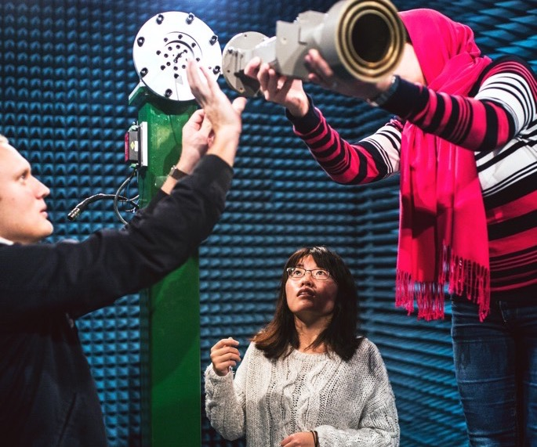
Education for the future
Over 100 degree programmes from qualifying courses to lifelong learning
Innovation and entrepreneurship
Challenge driven education
Gender equality and diversity
Sustainability/global goals for sustainable development
Education abroad
Attractive degree
Notes:
Lifelong learning Flexibilitet I tid och rum (fr ÅR) Tillsammans med strategiska partners.
Karriärenkät, ledningskansliet
Framtidens Utbildning (Ramverk. 13 principer) Ständig utveckling, I inledande rader.
Digitalisering I Utbildning. Förändringar I utbildningsformer. Pågår.
Equality mandatory
Study abroad opportunities, large number – important with international experience
Cooperation with leading universities worldwide
Attractive students
Utbildar en tredjedel av landets civilingenjörer
Challenge driven education – Team work with industry
KTH is Sweden’s largest technical university
KTH offers almost 100 degree programmes at first cycle and advanced level that together attract around 13,000 students from all round the world.
KTH encourages the development of innovative ideas and an entrepreneurial spirit in students. Both as part of its courses and via its innovation support department, KTH Innovation. (More on KTH Innovation later in this presentation)
Challenge driven education - resolving genuine problems - provides good preparation for a future career. These study programmes are kept relevant by close collaboration with the enterprise sector and the surrounding society, of which the strategic locations of our campuses are part.
Learning to work together in teams at KTH is an integral part of courses and each course always has insights from the very latest research.
From autumn semester 21, all study programmes will include a mandatory part on gender equality and diversity.
Sustainable development is important in all KTH courses and integrated into programmes. Education at KTH equips students with the relevant tools to be able to help develop society in a sustainable direction after graduating.
A range of different options to study abroad, such as exchange studies at one of KTH’s 220 partner universities, degree projects and summer courses abroad. A majority of respondents in the KTH career survey of 2018 (55%) have chosen to study abroad for a period.
97 percent of graduates found a job after completing their degree, over half of whom had actually done so before taking their final exams (career survey 2018).

Slide 13

Education at first cycle and advanced level
Circa 30 programmes at first cycle and circa 60 master’s programmes within:
Architecture and Built Environment
Engineering Sciences in Chemistry, Biotechnology and Health
Energy and Environment
Industrial Engineering and Management
Electrical Engineering and Computer Science
Engineering Sciences, Mechanical and Vehicle Engineering
Engineering Physics and Applied and Computational Mathematics
Design and Product Realisation, Engineering Materials Science
Technology and Learning
Open Entrance and Qualifying Educations
Notes:
Beskrivande text fron OM KTH
SE ÖVER OMRÅDEN fr kurssidor
Wide range of programmes on bachelers and masters level. 60 masters programmes taught in English
Skolor!!
Architecture and Built Environment
Engineering Sciences in Chemistry, Biotechnology and Health
Energy and Environment
Industrial Engineering and Management
Electrical Engineering and Computer Science
Engineering Sciences, Mechanical and Vehicle Engineering
Engineering Physics and Applied and Computational Mathematics
Design and Product Realisation, Engeneering Materials Science
Technology and Learning

Slide 14
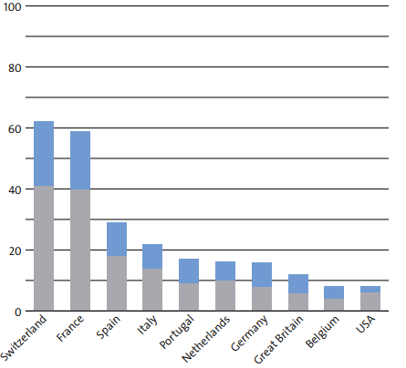
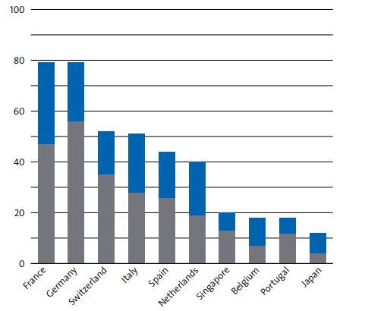
Student exchange – most popular countries 2021
Number of students who began student exchange during the year: the most popular countries KTH students travel to
Number of students who began student exchange during the year: the most popular countries exchange students originate from
Outbound women
Outbound men
Inbound woman
Inbound men
Notes:
HA KVAR!
KTH offers wide-ranging opportunities for students to study abroad. In addition to exchange studies, KTH offers double degree studies, degree projects abroad and summer courses abroad.
KTH has exchange agreements with 220 leading universities around the world.
In 2021, 296 (348) students commenced studies abroad. The reason why the number is still low is due to COVID-19, among other things. KTH decided to cancel international student mobility that had not commenced in the spring semester of 2021. Ahead of the autumn semester 2021, KTH's position has been that study abroad can continue in countries to which Sweden’s Ministry for Foreign Affairs has not advised against non-essential travel. Since August 2021, the advice against non-essential travel has been lifted for most non-European countries. However, most non-European universities chose not to accept exchange students during the autumn semester of 2021.
In 2020, 521 (635) students began exchange studies at KTH. Here too, the ongoing pandemic has had an impact in the number. Within Europe, most students came from universities in France, Germany, Switzerland, and Italy.

Slide 15
Number of fee paying students 2018-2020 per country of previous education
Notes:
Två bilderna eftervarandra blir en
Byt number of fee paying – International degree programmes
Vilka studenter som kommer in och laser hela program – masterstudenter, hur manga utomeuropeer och icke eutopeer.
Highlighta hur många de är på total
Europee/ icke europee
Vanligaste länderna förutbbildningsländer
Approx xx feepaying students per year
Studentexempel – varför valde de KTH
Selective admission

Slide 16
Total number of students per previous education country
Notes:
MASTERPROGRAMMEN
Betalar och betalar inte
Total number of students per previous education country (Figures from AS20)
China, Sweden and India were the most common countries in 2020. KTH also accepts a large number of students from European countries, such as Germany, Italy, Britain, Spain, Greece and Iceland. It is worth noting that the Covid-19 pandemic led to a fall in the number of international students at KTH and worldwide in 2020. This downturn affected certain countries more than others, depending, for example, on difficulties related to travel restrictions, financing or uncertainty about the spread of the virus.

Slide 17

Strategic partnerships with international universities
University of Illinois
University of Tokyo
Shanghai Jiao Tong University
Hong Kong University of Science and Technology
Indian Institute of Technology Madras
Nanyang Technological University, Singapore
Notes:
Tillkommit fler?
USA borta?
KTH has entered into strategic partnerships with a number of leading universities of technology. These partnerships span several business areas and include both traditional student exchanges and research collaborations, such as joint masters and doctoral programmes. These strategic partner universities strengthen KTH’s research, education and collaboration in general and help enable KTH in building an international brand.
KTH: strategic partner universities:
University of Illinois at Urbana-Champaign, USA
Nanyang Technological University, Singapore
Shanghai Jiao Tong University, China,
Indian Institute of Technology Madras, India
Hong Kong University of Science and Technology, Hong Kong
University of Tokyo, Japan.
The partnership with the University of Tokyo is as part of Stockholm Trio, together with the Karolinska Institute and Stockholm University.
For more information on strategic partnerships with international universities, see: https://www.kth.se/en/om/internationellt/strategiska-partneruniversitet/strategiska-partneruniversitet-1.532013

Slide 18

Research at KTH

Slide 19
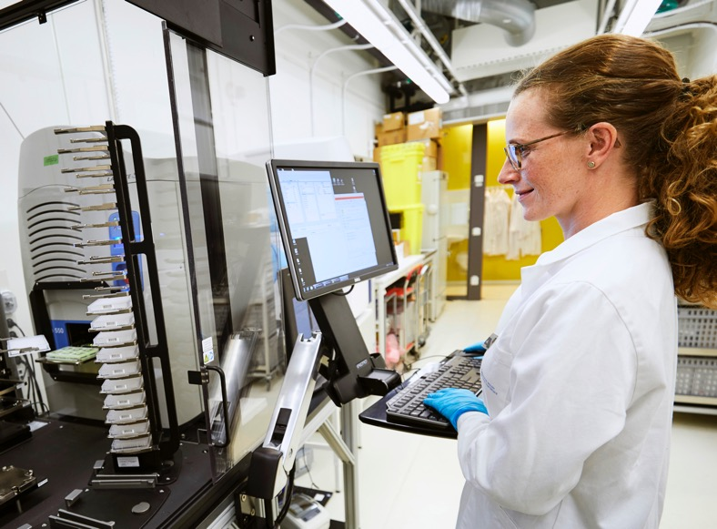
Excellent research
.
KTH’s research and education spans:
Engineering Sciences
Natural Science
Architecture
Industrial Economics
Urban Planning
History of Technology
Philosophy
Learning
Notes:
The breadth of KTH research requires variation in focus, approach and structuring. We look to create an open atmosphere and to break down traditional barriers between subject disciplines. Pure and applied research are pursued in parallel, and the same goes for multidisciplinary and subject-oriented research.
KTH’s research and education spans:
Engineering Sciences
Natural Science
Architecture
Industrial Economics
Urban Planning
History of Technology
Philosophy
Learning
Based on strong areas of research at KTH, six focus areas have been created. These work as platforms for multidiciplinary research.
Digitalisation
Energy
Transport
Materials
Life Science Technology
Industrial Transformation

Slide 20
Research platforms for interdisciplinary collaboration
Energy
Materials
Digitalisation
KTH
Transport
Industrial Transformation
Life
Science Technology
Notes:
At KTH's 27 departments, research is conducted on both basic and applied level. The research platforms are interdisciplinary and academic strong research areas at KTH, which bring together researchers from all over the organisation. The platforms enable research collaborations between different disciplines, with different perspectives to solve complex societal challenges.
Based on strong areas of research at KTH, six focus areas have been created as platforms for multidiciplinary research.
Digitalisation
Energy
Transport
Materials
Life Science
Industrial Transformation
The platforms:
Acts as a catalyst for multidisciplinary research initiatives to be jointly carried out by research groups at KTH together with relevant external partners
Builds and maintains internal and external relations
Enhance external KTH visibility and recognition (OBS: Det här är inte ett uttalat uppdrag. Kan stå kvar, men bara så du vet ☺)
Contributes to make KTH a globally recognized leader of innovative multidisciplinary research

Slide 21

Research centres
Interdisciplinary collaborations
Specific problem areas
More than 50 research centers at KTH
Can include both pure
and applied research
Competence building
and critical mass
A meeting place to catalyze innovations
Notes:
Research centres at KTH are interdisciplinary organizations that bring together researchers and research groups to collaborate on specific research topics or fields. By pooling resources and expertise, these centres aim to address pressing issues and challenges in their respective fields, and to promote innovation and creativity in research.
Research centres are an example of how KTH engages in long-term collaboration with different parties.
There are around 50 physical or virtual research centres based at KTH. Within the parameters of these centres, KTH collaborates with leading companies, other universities, the public sector and institutes.
A structured form of collaboration to focus on a specific problem area
There are more than fifty different research centres based at KTH.
Research centres can include both pure and applied research in collaboration with partners
• Allows long-term competence building and critical mass
• Meeting place between individuals to catalyze innovations
More information on reserach centres at KTH is available here: https://www.kth.se/en/forskning/sarskilda-forskningssatsningar/kompetenscentra/centrumbildningar-1.1156831

Slide 22



Research infrastructures
Support advanced research
Meeting places for academia, industry and other societal organisations
Open to external parties
Range from national
to small labs
KTH research infrastructures
12 infrastructures within four main areas
National infrastructures
KTH hosts six national infrastructures and
is a partner in another eight
KTH research facilities
Different labs and test beds
Notes:
Research infrastructures refer to the equipment and technology resources that support advanced research in a particular field. These may include specialized laboratories, advanced equipment, and other technical resources.
KTH's research infrastructures act as meeting places for academia, industry, and other societal organisations.
KTH recognizes the importance of collaborating with the wider society to create sustainable national research infrastructures and to foster positive societal development and offer other universities and companies the opportunity to use equipment. By bringing together different expertise and knowledge, new synergies and collaborations can be developed to enhance research and innovation.
KTH's research infrastructures range from large national research labs to small labs and expensive individual instruments. KTH also has testbeds that are utilized for research, education, and innovation, often in partnership with companies and the surrounding community.
Established research infrastructures
KTH has developed and maintains established research infrastructures to support research within specific fields. These infrastructures are focused and tailored to meet the specific needs of KTH's research community.
KTH's established research infrastructures are strategically designed with a long-term plan for organization, quality assessment, funding, and societal impact. They are easily accessible to multiple users and are frequently utilized.
KTH has 12 internally established infrastructures within four main areas:
ICT
Centre for High Performance Computing PDC
Sustainable Power Lab
Visualization studio VIC
The Language Bank for Speech
Life Science Technology
Advance Light Microscope Laboratory
National Genomics Infrastructure NGI
Jonasson Centre of Medical Imaging
Nanofabrication
Electrum Laboratory
NanoLab Albanova
Materials
Hultgren Laboratory
Odqvist Laboratory
2MiLab
National infrastructures
KTH hosts or partners with multiple national research infrastructures that are funded by the Swedish Research Council to support interdisciplinary research across institutions throughout Sweden. These national infrastructures offer comprehensive capabilities that enable advanced research.
KTH hosts six national infrastructures and is a partner in another eight national infrastructures.
Other research environments
KTH has access to other types of infrastructure, testbeds, and environments, for example, laboratories and specialised technical equipment for testing, demonstrations, and verification of concepts. Many of these facilities are also available for external researchers and companies

Slide 23
Horizon 2020 grants
Excellent Science
€ 98,2
58%
Societal Challenges
€ 28,8
17%
Industrial
Leadership
€ 27,8.
17%
Other
€ 13,2.
8%
Notes:
Horizon 2020 is the framework program that applied in 2014 -2020. Within Horizon 2020, funding for research and innovation has been granted during the period for a total of approximately EUR 65 billion, the total budget is close to EUR 80 billion. Horizon 2020 is an important financier for KTH. KTH has participated in 328 projects with a grant value of EUR 168 million (June 2021).
The largest number of participations for KTH, as well as grants awarded, are within the Excellent Science pillar. Within this, KTH has been granted 164 projects and approximately EUR 98 million. KTH has been granted 30 ERC (European Research Council) and 77 MSCA (Marie-Skɫodowska-Curie Actions).
KTH also has a high level of participation in the Industrial Leadership pillar, especially in the information and communication technology (ICT) program. KTH has been granted 49 participations in ICT to a value of approximately EUR 23 million.
Within the third pillar, Societal Challenges, KTH has participation in 79 projects, of which seven as coordinator, to a total value of approximately EUR 29 million.
In addition to presence in the three pillars, KTH has also participated in Euroatom (17 participations for an approved amount of approximately EUR 10 million), Spreading excellence and widening participation (six participations for an approved amount of approximately EUR 3 million) and Science with and for Society (3 participations to an amount granted of approximately EUR 0.5 million).
The outcome of KTH's participation in Horizon 2020 is reported in a special report.

Slide 24
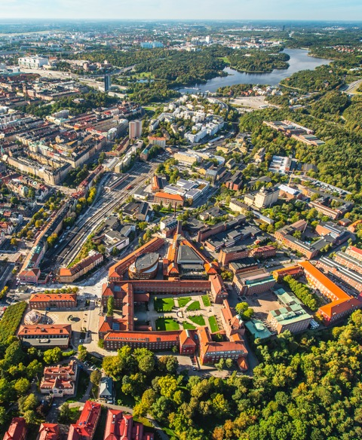
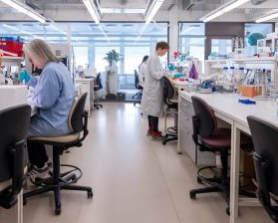
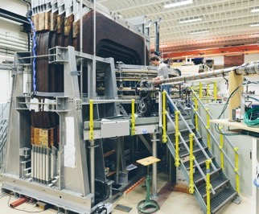
Impact through collaboration
  Collaborations
  Industry
  Academia
  Society
  Research institutes
  Personal mobility
  Adjunct professors
  Industry-employed doctoral students
  Affiliated faculty
Notes:
Close collaborations industry, academia and society provide good opportunities for implementation of research results.
Researchers and students get the opportunity to work in an excellent academic environment and at the same time have a close connection to the surrounding society.
Personal mobility - that people shift between KTH and the surrounding society, is a way to identify and find innovative solutions. KTH allows industry to take part in our research environments and we get valuable contacts in industry.
Examples are:
Adjunct professors (40 adjunct professors)
Industry-employed doctoral students (292 Industry-employed doctoral students )
Affiliated faculty (32 affiliated faculty)
Numbers from 2020
Source: HR+
More information about personal mobility at KTH can be found here: https://www.kth.se/en/samverkan/partnerskap/personrorlighet/personrorlighet-1.341481

Slide 25
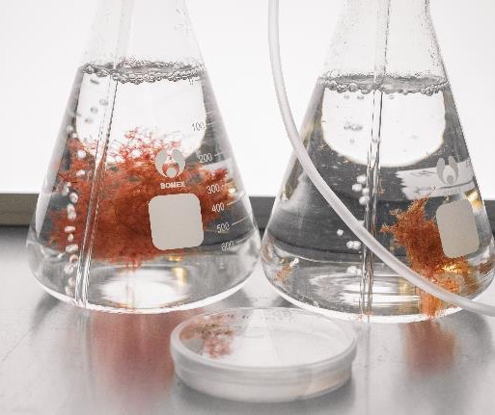
Innovation at KTH
KTH’s innovation support is internationally acknowledged
Students, researchers and employees at KTH are given the opportunity to create benefits and impact with ideas and research
The KTH Innovation Readiness Level model is used by hundreds of organisations around the world
Every year, around 350 ideas start the journey from idea to innovation
Notes:
Every year, around 350 ideas, originating from KTH research and education, start the journey from idea to innovation.
Since 2007, KTH has developed internationally acknowledged innovation support.
The KTH model for innovation support, the KTH Innovation Readiness Level model is used by hundreds of organisations around the world.. These include Vinnova, Imperial College, Aalto, the Technical University of Denmark (DTU) and Chalmers. The model was inspired by the NASA Technology Readiness Levels, and spans six areas relevant for innovation development.
Via a well-developed and open innovation process, KTH helps students and researchers to transform ideas into innovations. Support includes coaching, plus legal and financial advice.
PHOTO: Volta Greentech is a KTH start-up aiming to reduce greenhouse gas emissions from cattle by up to 80% with the aid of algae.
https://www.kth.se/en/om/innovation/om/nyheter/teamet-som-vill-stoppa-kornas-utslapp-1.987007

Slide 26


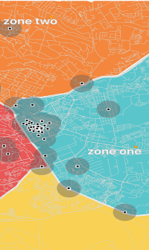
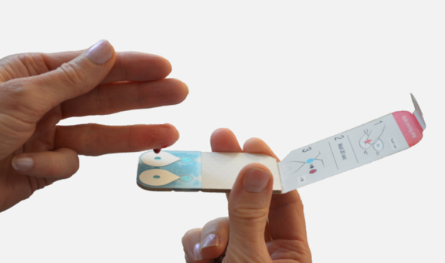
Examples of ideas that have become innovations
Re:newcell
Capitainer
Ellure
Addressya
Notes:
Examples of ideas originated at KTH and developed into new businesses and companies.
Re:newcell: Only 1% of all cloth produced is recycled into new products today. Researchers at KTH developed a way to break down cellulose into a new raw material. Re:newcell is now one of the only companies that can recycle clothing on a large scale. Re:newcell was founded by Mikael Lindström and Gunnar Henriksson, both professors at KTH.
Capitainer makes it possible for patients to provide blood samples at home. The solution, Capitainer qDBS, is a sample taking system for dried blood that can also be used to test for Covid-19 at home. Capitainer was founded by Docent Niclas Roxhed, Professor Göran Stemme and doctoral student Gabriel Lenk from KTH, business consultant Peter Breutigam, and Olof Beck from the Division of Clinical Pharmacology at the Karolinska Institute.
KTH start-up Ellure can print a lipstick in the exact colour you want in 60 seconds. The journey started when two KTH students wanted to find a way to reduce waste in the cosmetics industry. They came up with the idea of producing make-up on demand that means the make-up is more personal as it can match every shade and style you want. Ellure was founded by KTH students Selah Li, Jasmin Sabir, Tiger Hu Shanya and Andres Amezcua Hidalgo.
Addressya. Four billion people in the world have no fixed address, which means they cannot exercise their citizens’ rights, open a bank account, guide an ambulance in an emergency situation or order goods for home delivery. Addressya has been developed as a digital solution that gives people a complete and easy to use address. Addressya was founded by Karoline Beronius and Maria Cheadle. Beronius was a KTH employee at the time.

Slide 27

National and international collaboration

Slide 28
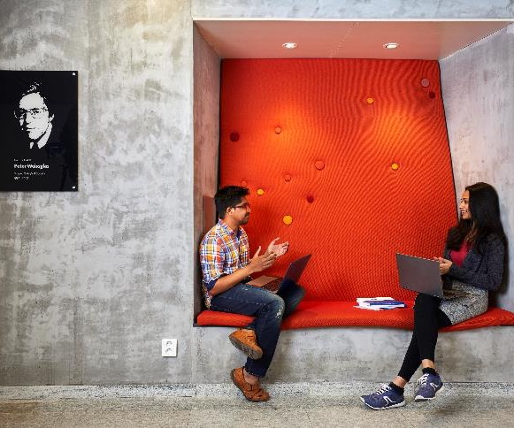
Collaboration for a better future
High quality research is benefiting society today and will do so in the future
Collaboration is a key component in enabling research findings to be implemented in society
Collaboration partners gain access to an advanced research infrastructure and laboratories
Regular interaction with a large alumni network offers good opportunities for different forms of collaboration
Notes:
High quality research is benefiting society today and will do so in the future.
Collaboration is a key component in enabling research findings to be implemented in society.
Collaboration partners gain access to an advanced research infrastructure and laboratories.
Regular interaction with a large alumni network offers good opportunities for different forms of collaboration.

Slide 29
Strategic partnerships - moving society forward
Knowledge
Society
People
Industry
Notes:
The aim of strategic partnerships is to develop long-term collaboration for mutual benefit.
Advantages for KTH:
Partnerships are a way for KTH to gain better business intelligence on the development, needs, challenges and strategies of important sectors. This enables a stronger development capacity, increases the quality of study programmes and research and boosts innovation capacity in students, teachers and researchers.
Advantages for KTH partners:
Assured know-how provision, access to knowledge and state of the art research, increased competitiveness and innovation capacity.

Slide 30













Strategic partnerships
Global companies
Public sector
Leading research institutes
Notes:
KTH has partnerships in three different areas:
1. Global companies – for knowledge development, technology development, know-how provision and greater competitiveness.
2. Public sector – for understanding of and jointly address social challenges and prioritised problem issues.
3. Leading research institutes – for the development and application of knowledge.
For more information on strategic partnerships see: https://www.kth.se/en/samverkan/partnerskap/kth-s-strategiska-partnerskap-1.678020

Slide 31





University networks
Notes:
In addition to collaborating with over 200 exchange universities worldwide, KTH is a member of a number of international university networks. These collaborations comprise, for example, a platform for international exchange, development of joint programmes and give KTH bigger opportunities to influence decision-makers concerning higher education at an international level.
CESAER
CESAER, the Conference of European Schools for Advanced Engineering Education and Research, acts as the united voice of universities of science and technology in Europe and drives relevant issues at European policy level.
CLUSTER
CLUSTER, the Consortium Linking Universities of Science and Technology for Education and Research, is a consortium of 12 elite European Universities in Science and Engineering.
Nordic Five Tech
Nordic Five Tech is a strategic alliance consisting of the five leading universities of technology in Denmark, Finland, Norway and Sweden. The alliance was formed in November 2006 with the aim of leveraging common and complementary strengths, and to create synergies within education, research and innovation.
Unite!
Unite! – the University Network for Innovation, Technology and Engineering - consists of seven elite universities in seven European countries. Unite! is part of the European Universities Initiative. The aim is to create a new European university model via joint study programmes, virtual and physical mobility, innovative teaching methods and harmonised governance models. Collaboration has also been extended to research and innovation in 2021.
ISCN
The mission of the International Sustainable Campus Network (ISCN) is to provide an international forum to support higher education institutions in the exchange of information, ideas, and best practices for achieving sustainable campus operations and integrating sustainability in research and teaching.
STHLM Trio
In 2019, the Karolinska Institute, KTH and Stockholm University entered into the Stockholm Trio University Alliance to develop and promote the internationally elite research and education environment that the three universities form in the Stockholm region.
For more information on strategic partnerships with university networks see: https://www.kth.se/en/om/internationellt/natverk

Slide 32

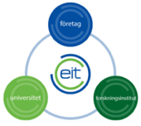
European Institute of Innovation and Technology - EIT
8 EIT Consortia, of which KTH is a member of 5:
EIT Digital: for a strong digital Europe
EIT Health: together for a healthy lifestyle in Europe
EIT InnoEnergy: pioneering changes within sustainable energy
EIT RawMaterials: making raw materials an important strength for Europe
EIT Urban Mobility: smart, green and integrated transport
Other EIT:
EIT Climate KIC
EIT Food
EIT Manufacturing
Notes:
EIT, the European Institute of Innovation and Technology, is an EU Agency established in 2008 to strengthen Europe’s ability to innovate and its competitiveness within strategically chosen areas. It is part of Horizon Europe, the EU’s key funding programme for research and innovation.
What does EIT do?
EIT drives innovation across Europe by creating and supporting collaboration between enterprise, education and research within certain strategic knowledge areas. It does this by creating consortia that include partners from leading companies, research institutes and universities, so-called Knowledge and Innovation Communities (KICs).
EIT brings together over 1,000 partners making it the largest innovation network in Europe. The aim is to modernise higher education, increase opportunities for mobility within the parameters of education, create job opportunities and sustainable economic development opportunities for Europe.
The results
8 KICs
Over 60 innovation hubs in Europe
Over 3,200 new start-ups
Ca 5,000 masters and doctorates awarded
KTH is a partner in five consortia, of which there is fierce competition for selection. The organisational structure and degree of involvement vary between the KICs, but a common denominator for most is that KTH has a huge commitment within joint programmes and that the majority of masters programmes that lead to a double degree have been created with EIT support. We also see more long-term commitment, such as the joint KTH and Uppsala University innovation centre within environmental science and engineering and sustainable energy solutions. KTH also participates in numerous research and innovation projects, which are applied for via annual calls organised by KICs.

Slide 33
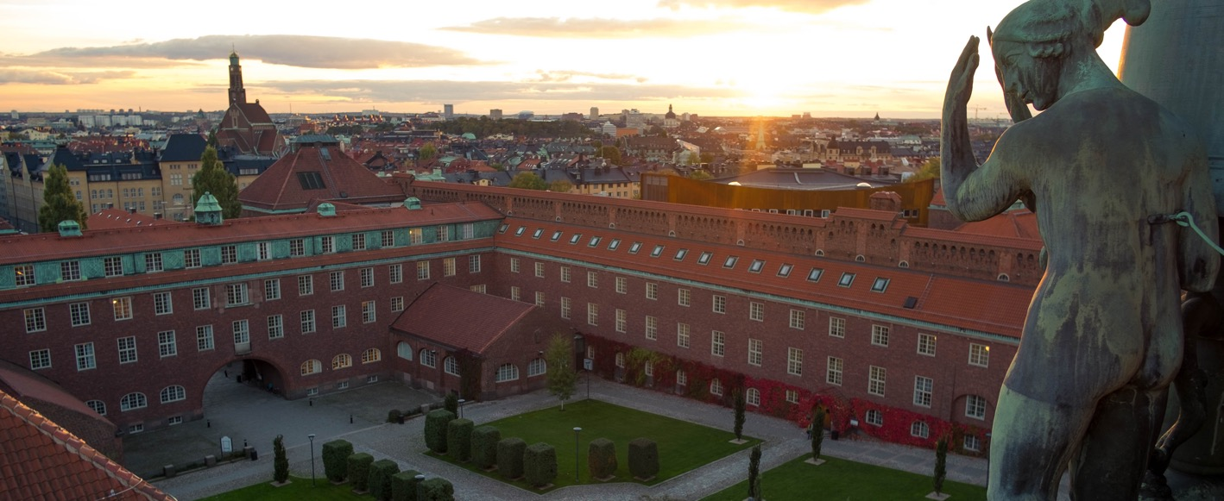
Financial information

Slide 34
Field of activity 2022 (2021)
Total msek 5,289 (5,317)
Percentage distribution |  | 2022 | 2021
 | First and second level studies | 29,2 | 30,6
 | Purchased courses | 0,1 | 0,2
 | Commissioned courses | 0,3 | 0,3
 | Research and doctoral studies | 67,7 | 66,4
 | Contract research | 2,7 | 2,6

Slide 35
Sources of income 2022 (2021)
Total msek 5,289 (5,317)
Percentage distribution |  | 2022 | 2021
 | Government grants for education first and second level studies | 23,5 | 24,5
 | Government grants for research and doctoral studies | 26,8 | 26,4
 | Research councils | 7,6 | 6,8
 | Other government agencies | 17,1 | 17,3
 | Strategic foundations | 3,2 | 3,7
 | EU | 5,1 | 5,1
 | Private/other | 16,7 | 16,2

Slide 36
Costs 2022 (2021)
Total costs msek 5,426 (5,238)
Costs |  | 2022 | 2021
 | Staff | 61,9 | 63,5
 | Premises | 18,2 | 18,6
 | Other operating costs | 15,7 | 13,8
 | Financial cost | 0,2 | 0,1
 | Depriciation | 4,0 | 4,0

