Slide 1
Research and education in electrical engineering and computer science
Add your name
Notes:
Edit the PowerPoint to fit your needs and the context in which you are presenting.
Add your name to the second headline on slide 1
Remove the pages that doesn’t fit the context of your presentation
Change the examples of research to your own research/research area
Change the example pictures of research to your own research/research area
Add your channels on slide 21

Slide 2
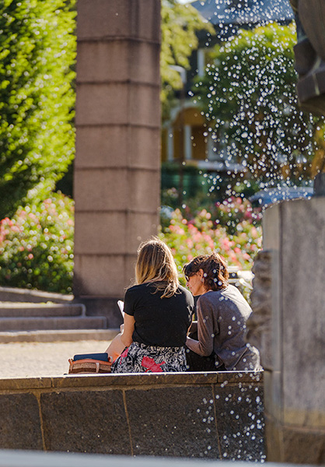
About KTH Royal Institute of Technology
KTH is Sweden's oldest and largest technical university
More than 13,000 full-time students
More than 1,700 doctoral students
Over 3,500 full time employees
Four campuses in the Stockholm region
Ranked as 36 in the world in Engineering & Technology (QS World University Rankings) and 7 in the world based on UN’s global sustainability goals (THE University Impact Rankings)

Slide 3
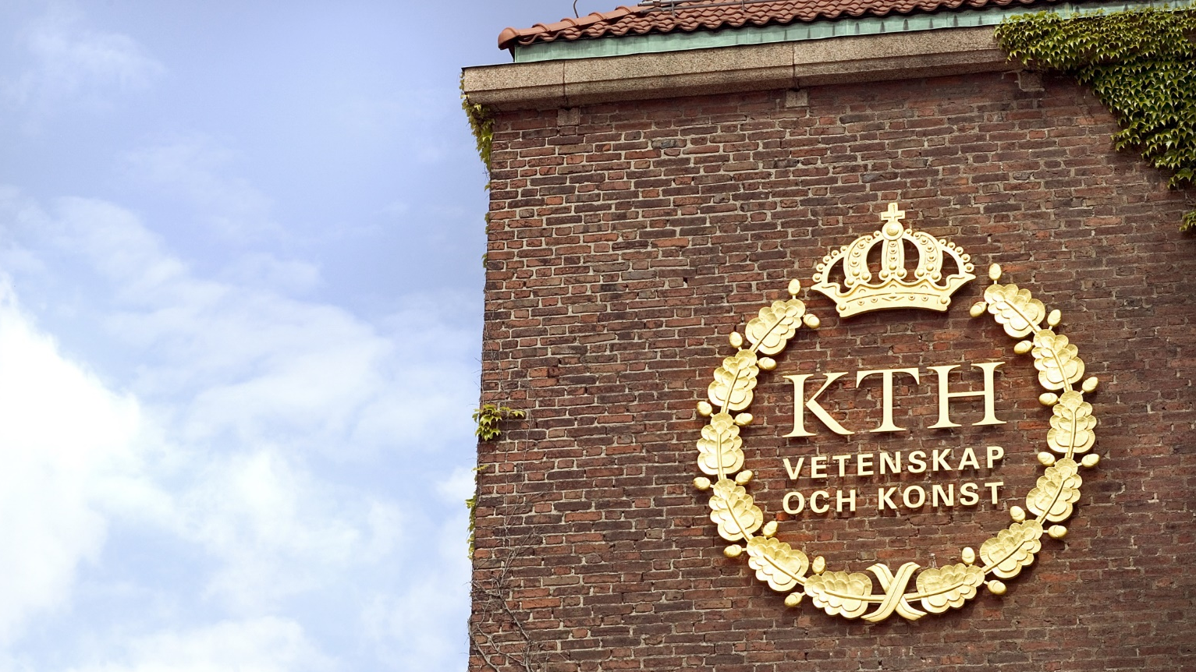
Electrical engineering and computer science

Slide 4
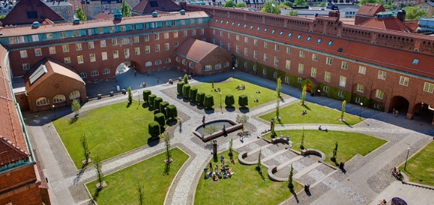
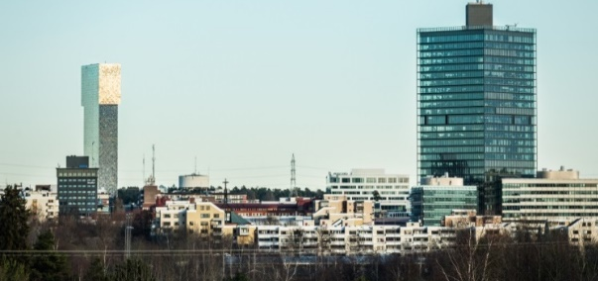
Electrical engineering and computer science
Research, education and co-operation in the broad area of Electrical Engineering and Computer Science.
Two campus areas:
Valhallavägen, central Stockholm
Kista, north of central Stockholm

Slide 5
Electrical engineering and computer science in numbers
5200
Number och Bachelor and Master students
1.1 bn SEK
(annual turnover in billion SEK)
478 projects
(with external funding)
of which 81are EU- projects
4 Master of Science Programmes
3 Bachelor of Science Programmes
1 Bachelor’s Programme in English
15 Master’s Programmes
4 Doctoral Programmes

Slide 6
International ranking lists
Electrical engineering and computer science at KTH places high on international rankings:
ARWU 2020
Automation and control (17)
Transport science and technology (24)
Telecommunication engineering (32)
Energy science and engineering (51-75)
Electrical and electronic engineering (38)
QS 2020
Electrical and electronic engineering (17)
Computer science and information systems (43)
THE 2020 (200 universitet)
Computer science (69)

Slide 7
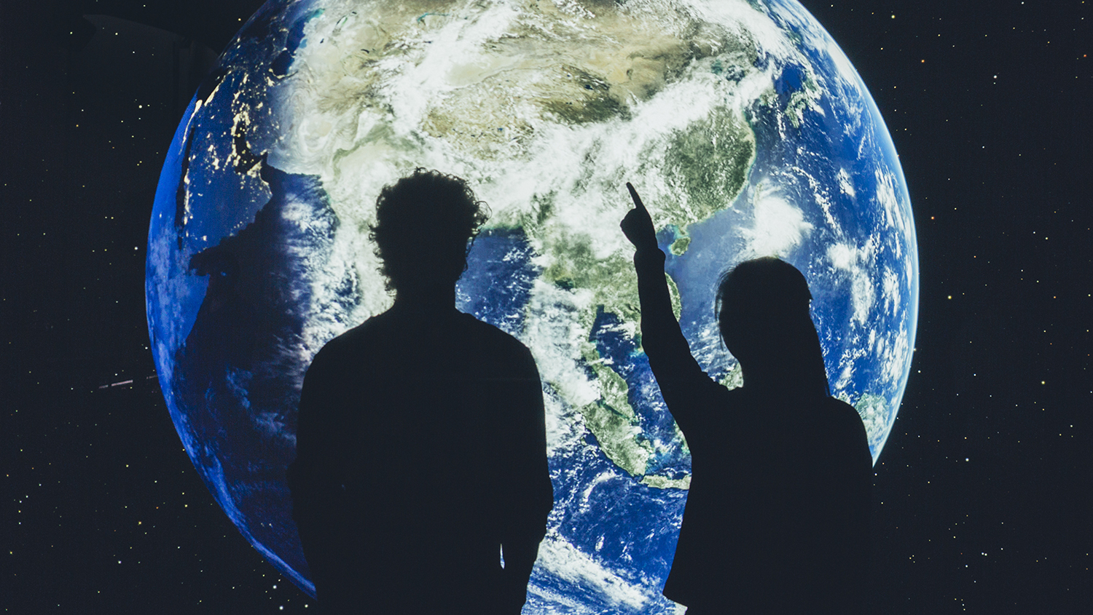
Education in electrical engineering and computer science

Slide 8
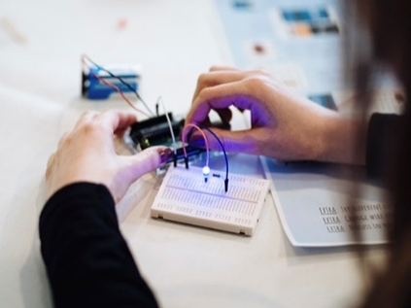
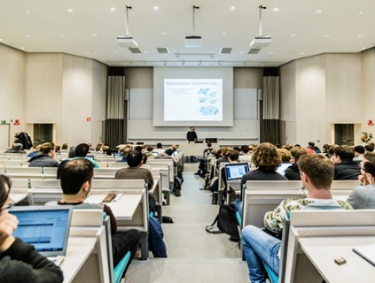
A new generation of engineers
Educating students to solve future global challenges
99 percent have a job one year after graduation
Digitisation, equality, internationalisation and sustainability
Programmes in constant development
Co-operation and real cases with external partners
Close relation to research in respective areas

Slide 9
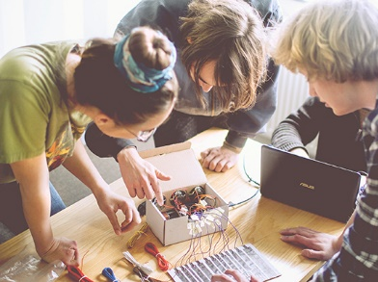
First and second cycle programmes
Programmes in English:
Bachelor's programme
Information and Communication Technology
Programmes in Swedish:
Master of Science in Engineering programmes
Computer Science
Electrical Engineering
Information Technology
Media Technology
Bachelor of Science in Engineering programmes:
Computer Science
Electronics and Computer Technology
Electrical Engineering

Slide 10
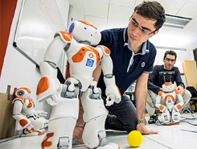
Master’s programmes
Computer Science
Electromagnetics, Fusion and Space Engineering
Electric Power Engineering
ICT Innovation
ICT Innovation (Joint EIT programme)
Embedded Systems
Information and Network Engineering
Interactive Media Technology
Communication Systems
Machine Learning
Media Management
Nanotechnology
Software Engineering of Distributed Systems
Systems, Control and Robotics
Security and Cloud Computing (SECCLO)

Slide 11
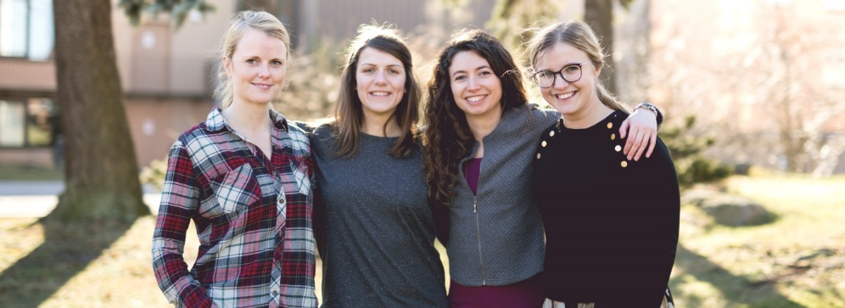
Doctoral programmes
Computer Science
Electrical Engineering
Information and Communication Technology
Mediated Communication

Slide 12
Research in electrical engineering and computer science

Slide 13
Research in electrical engineering and computer science
Internationally prominent research in several areas, for example:
energy systems
systems engineering
Electronics
communication systems
computer science
software development
human-computer interaction
16 research divisions with an international faculty
Using theoretical and multidisciplinary approaches

Slide 14
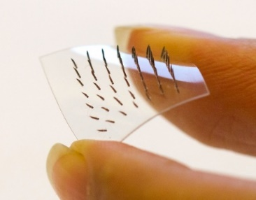
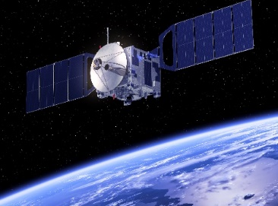
Research in electrical engineering and computer science
Contributing to sustainable development through innovations, new technology and dissemination of knowledge.
Notes:
Feel free to edit by adding images that fit your research/research area.

Slide 15
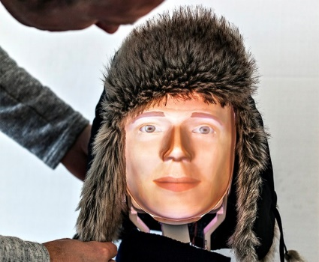
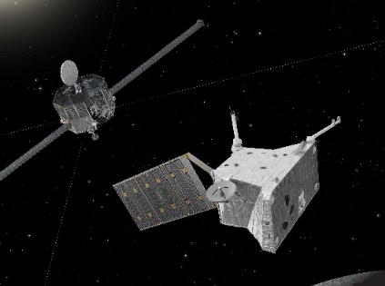
Examples of recent research
Furhat – the social robot making unbiased recruitments
Geocode – open source toolkit used by several major industries to develop application-based systems and applications
New synthetic plastic material for cancer treatment – directly in the cancer cell
Development of AI research within WASP
5G network and its security
Components heading for Mercury to investigate its magnetosphere
Robots being able to follow the movements and commands of a human – in real time
Notes:
Feel free to edit by adding examples from your research/research area.

Slide 16
Co-operation in electrical engineering and computer science

Slide 17
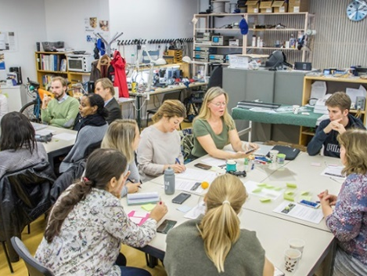
A partner for the future
Research and education performed in co-operation with the surrounding society, for example through:
strategic partnerships
industrial doctoral students
adjunct faculty
Industry driven master thesis projects and courses
Contract and distance education
Research co-operations with nationally and internationally prominent universities, industries and networks

Slide 18
Research centres
CAS (autonomous systems)
CASTOR (complex software development)
Centre for digitalisation (digitalisation)
Electrum laboratory (fabrication and characterization in the nano and micro scale)
NAVET (art, technology and design)
PDC Center for High Performance Computing (supercomputing)
SweGRIDS (smart grids)
Notes:
About research centres:
Effective models for collaboration in research and education
Exchanging experiences and knowledge
Meeting point for students, researchers, teachers and external partners
Place for recrutiment and academic collaboration

Slide 19
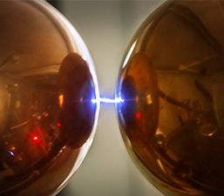
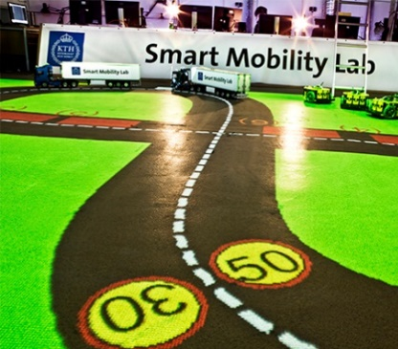
Infrastructures for research and education
Notes:
Note! The images led to videos describing each environment.
At the school, we have access to several excellent and unique research and education environments, any of which are totally unique:
• Anechoic Chamber
ELAB clean room laboratory
• Electrum clean room laboratory https://www.youtube.com/watch?v=4liP_VYaDg0&list=PLck88Xvvwp7ihUYQsRGDEtCVtLdCFsJQL&index=11&t=
• Fusion plasma device EXTRAP T2R
• High voltage lab https://www.youtube.com/watch?v=BqgfDMrcO0s&list=PLck88Xvvwp7ihUYQsRGDEtCVtLdCFsJQL&index=14&t=
• KTH R1 Experimental Performance Space
• Lab for Media and Interaction Technology
• Maxwell Laboratory
• PDC Center for High Performance Computing https://www.youtube.com/watch?v=662YYyOo12Q&list=PLck88Xvvwp7ihUYQsRGDEtCVtLdCFsJQL&index=12&t
• PMIL Lab
• Robotics Lab
• Smart Mobility Lab https://www.youtube.com/watch?v=swtg4Qnwtb4&list=PLck88Xvvwp7ihUYQsRGDEtCVtLdCFsJQL&index=13&t
• Space and Presence Laboratory
• Space Electronics Lab
• Sustainable Power Lab
• Usability, Haptics and Interaction
• Visualization Studio VIC

Slide 20
Follow KTH
Facebook
facebook.com/KTH
facebook.com/ktheecs
Twitter
@KTHinfo
@KTHuniversity
@KTHresearch
YouTube
youtube.com/KTH
Instagram
@kthstudent
@kthuniversity
Web
kth.se
kth.se/eecs
Follow me:
Link to your profile page or other channel

Slide 21
Thank you!
kth.se/eecs
Photos: Adam af Ekenstam, Abraham Engelmark, Patrik Lundmark, Kyriaki Sarampasina, Tobias Ohls, Linus Hallgren, Petter Cohen, Håkan Lindgren, Jann Lipka, Andreas Bergsten

